Slide 1
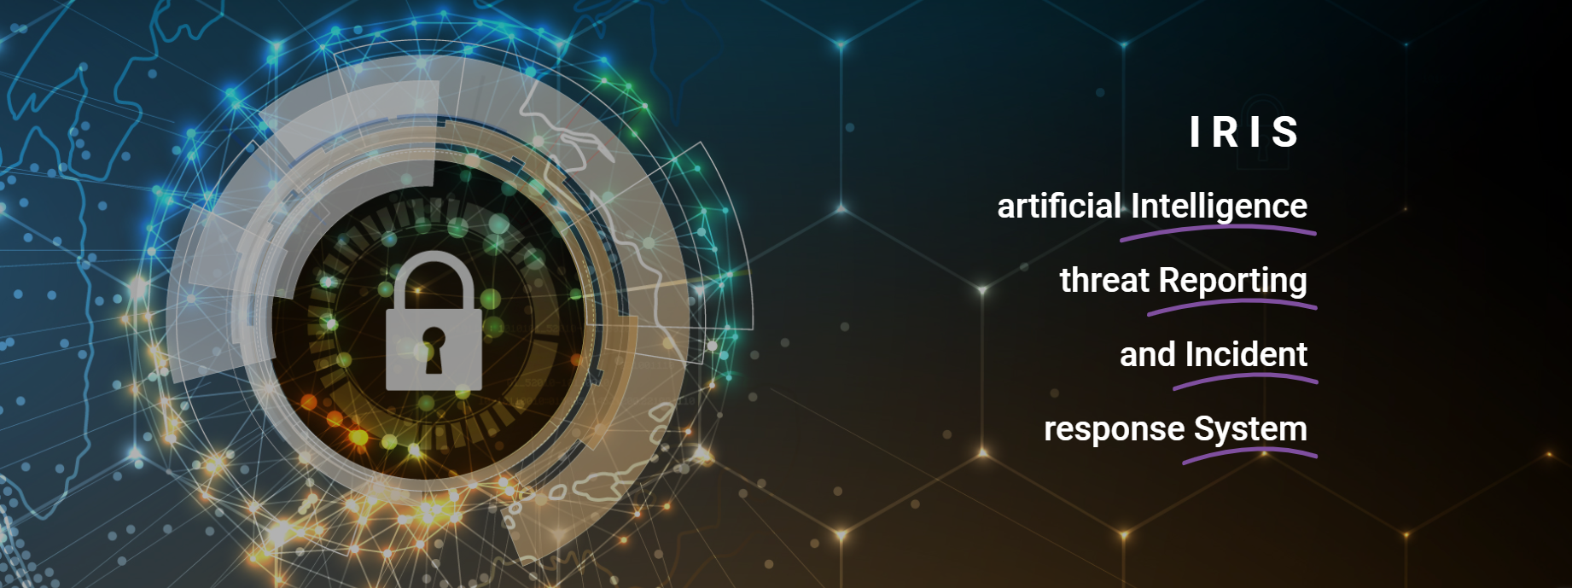

Slide 2
IRIS A collaborative CERT/CSIRT platform to combat cyber-threats in IoT and AI-driven systems
Gonçalo Cadete (INOV)
René Serral Gracià (UPC)
07/03/2024

Slide 3
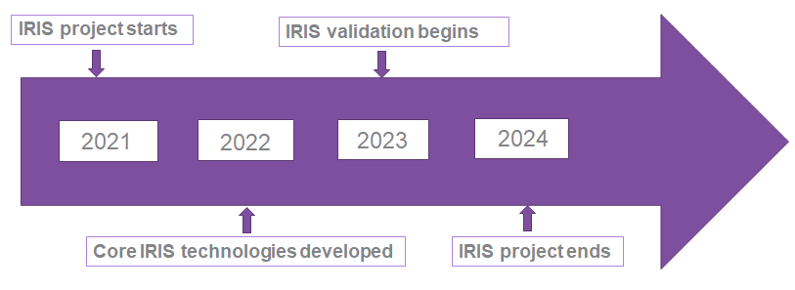
Project at a Glance
Call Identifier: 2020-SU-DS-2020
Topic: SU-DS02-2020 Intelligent security and privacy management
EC Funding: 4 918 790.00 EUR
Duration: 36 months (Sept 2021-Aug 2024)
Consortium: 19 partners
Coordinator: INOV - Instituto de Engenharia de Sistemas e Computadores, Inovacão, (INOV), Portugal
Learn More: www. iris-h2020.eu
Join us: @iris-h2020
IRIS H2020 Project
6 Public organizations
3 SMEs
4 Large ICT industries
6 Research institutions & Universities
Consortium

Slide 4
IRIS Motivation
As existing and emerging SMART CITIES continue to expand their IoT and AI-enabled systems, novel and complex threats are introduced.
Architecture and behaviour of emerging IoT and AI technologies are not currently well understood by security practitioners, such as CERTs and CSIRTs.

Slide 5
IRIS Vision
The H2020 IRIS project aims to deliver a framework that will support European CERT and CSIRT networks detecting, sharing, responding and recovering from cybersecurity threats and vulnerabilities of IoT and AI-driven systems.
Complement the existing MeliCERTes open platform and tools.
The IRIS Platform will be made available, free of charge, to the European national CERT and CSIRTs, by the end of the project.

Slide 6
IRIS Objectives
To identify the user, technical and business requirements and design the architecture of an AI threat reporting and incident response system
To analyze the relevant ethics principles and legal framework on privacy concerns
To develop a collaborative platform for ICT stakeholders and European CERTs/CSIRTs for the successful operation of IoT and AI-enabled ICT systems
To demonstrate and validate the integrated IRIS platform across three realistic pilot demonstrators in three smart cities
To ensure wide communication and scientific dissemination of the IRIS results, efficient exploitation and contribution to relevant standardization bodies

Slide 7
Social Acceptance Assessment
This session is also part of our research on the social acceptance of IRIS project
The aim is to get a feedback on the demonstration based on your perceptions
First you will see the demonstrations then you will participate in a survey and then in a small focus group

Slide 8
Social Acceptance of Technology IRIS model
BASED ON 3 PRINCIPLES
Human centredness,
Leave no one behind
Ethics-by-design
WHO: Smart Urban Transport stakeholders to assess the IRIS technology
WHAT: perceptions on the IRIS Platform.
HOW: demos + survey + discussion group to assess different dimensions of social acceptance
Notes:
We focus on social acceptance because it has become clear that the acceptance of innovation is not only due to technical features of a product or of a solution but also to other variables such as behavior, opinions, awareness, attitudes and beliefs.
At cybersecurity Lab we elaborated a model to assess Social Acceptance at different stages of the research and design process.
CyberEthics Lab. developed a methodology to assess social acceptance of technology SAT (Occhipinti et al. 2022) which takes social acceptance as a function of user experience, combined with perceived disruptiveness of the technical solution, its impact on values and trustworthiness.
Out model is based on three principles: We take the social acceptance of a solution as a function of four components, called bubbles.
SAT can be applied not only with end-users but also with other stake holders
SO today you are the experts we would like to assess the iris technology, and we are interested in your expectations perception… we will conduct this focus groups and then ask you to fill in a survey.

Slide 9
Value
Our own values provide us with some form of orientation on how to behave.
Values are embedded in technology
Values are spread throughout society
Value as something good and desirable
Notes:
The notion of value that we use is the following:
Value embodies the idea of something good and desirable.
Our own values provide us with some form of orientation on how to behave. We live, we work according to certain values. We struggle when we have to behave in a way that doesn’t comply with the values that are important for us. Values are individual, but they are social as well. They depend on our social life, our family, our education, our political views, the country we were raised in, the people we interact with along our daily life, our career, our position in society, our political, religious and moral standing.

Slide 10
Barcelona PUC Demo: 1st Round of Pilots
IRIS Consortium
PUC1 Demo Meeting|07/03/2024

Slide 11
Agenda
PUC1 Overview & IRIS Architecture
User Story 1 Outline and Demo
User Story 2 Outline and Demo
Description of IRIS tools

Slide 12
PUC #1 - Overview
Securing the smart city’s IoT and control systems against confidentiality & integrity breaches
Notes:
The city of Barcelona has implemented a multi-faceted IoT edge-cloud infrastructure combining and collecting telemetry from a vast array of existing devices and systems (e.g., lampposts, parking, traffic, ambient sensors, RF sensors), with visibility, control and functionality via retrofitted wireless access points (SmallCells, LTE, WIFI) with virtualization capabilities.

Slide 13
PUC #1 Description (1)
Test and validate IRIS platform in the city of Barcelona:
Leverage existing systems, IoT devices (e.g., lampposts, parking, traffic, ambient sensors, RF sensors) and wireless access points (SmallCells, LTE, Wi-Fi) with virtualization capabilities, installed in tram station from the H2020 European Project Pledger.
Ensure that the IRIS platform will be able to successfully detect possible malicious traffic to the IoT systems and their data telemetry, which may lead to their compromise.
Test and validate IRIS ability to report efficiently and effectively the impact of possible breaches in the IoT and control systems.

Slide 14
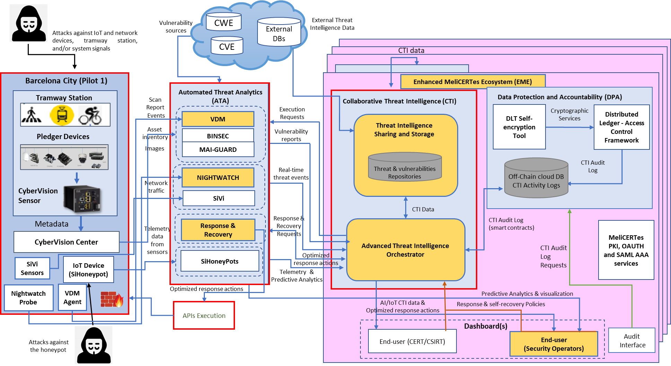
PUC #1 and IRIS platform Architecture

Slide 15
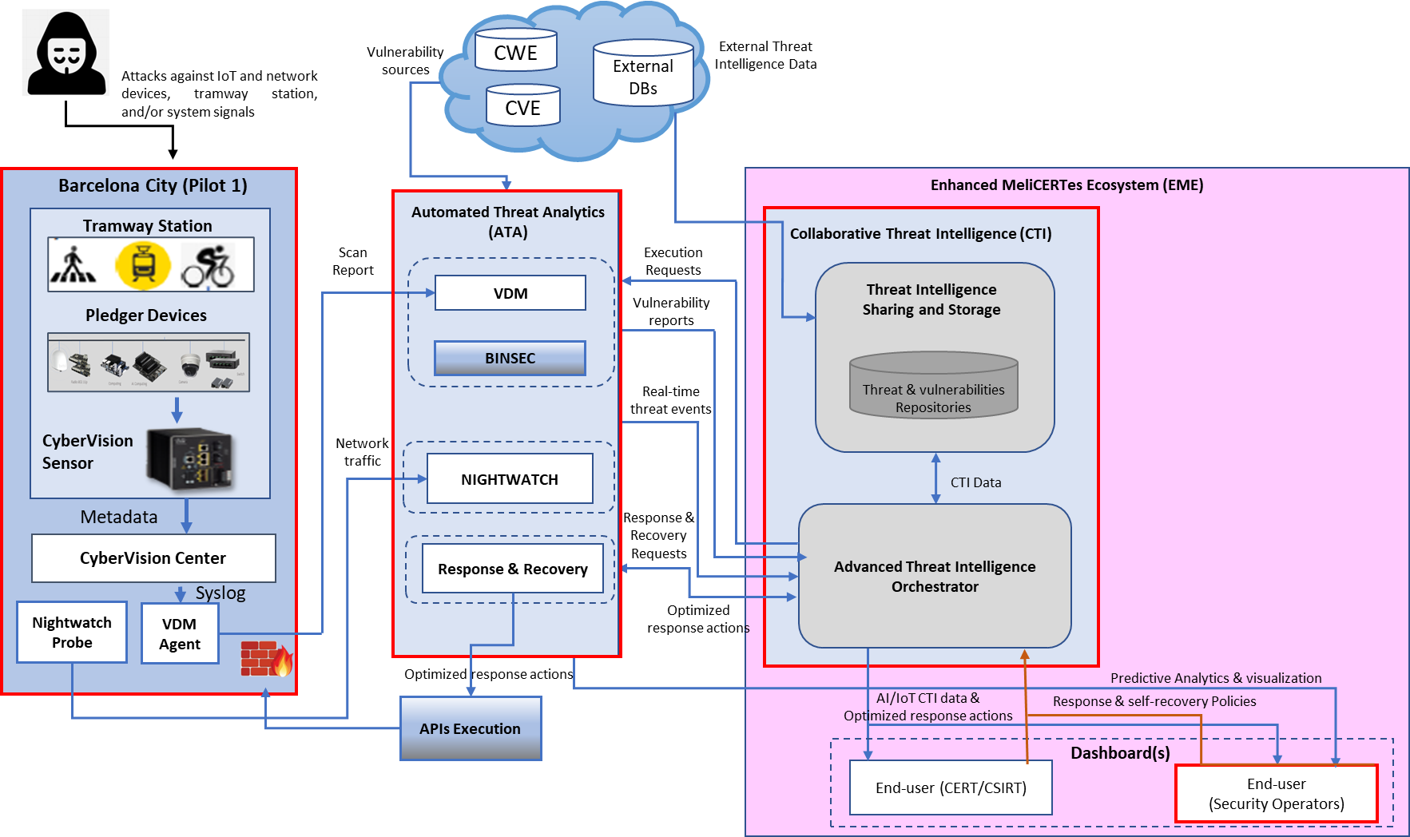
PUC #1 Architecture and IRIS tools
CTI:
ATIO (ICCS)
CTI Sharing and Storage (CERTH)
EME (INTRA)
ATA:
VDM (ATOS)
Nightwatch (CLS)
RRR (CLS)
Infrastructure:
IMI
CISCO
UPC

Slide 16
PUC #1 Architecture and IRIS tools
ATA:
VDM (ATOS)

Slide 17
Vulnerability Discovery Manager (VDM)
IoT & AI-provision risk and vulnerability assessment
Susana González / Eviden

Slide 18
Vulnerability Discovery Manager
An Overview
Description:
The Vulnerability Discovery Manager (VDM) is one of the components included in the IoT and AI-Provision Risk and Vulnerability Assessment Module of the IRIS Platform. The VDM is used for the dynamic identification, analysis and reporting of vulnerabilities detected on networks with IoT devices and AI-provision systems.
Main functionalities:
Dynamic identification of vulnerabilities on the target infrastructure.
Impact assessment to classify and assign priorities to the vulnerabilities detected (enrichment with CWE, CAPEC and MITRE ATT&CK) .
Risk assessment of the infrastructure considering the vulnerabilities identified and the relevance of the assets where they were found to suggest mitigation measures.
Intelligence sharing functionalities so the information about the vulnerabilities can be shared with authorized CERTS and CSIRTs.
A novel automated pentesting AI-based engine to orchestrate penetration activities.
18

Slide 19
PUC #1 Architecture and IRIS tools

Slide 20
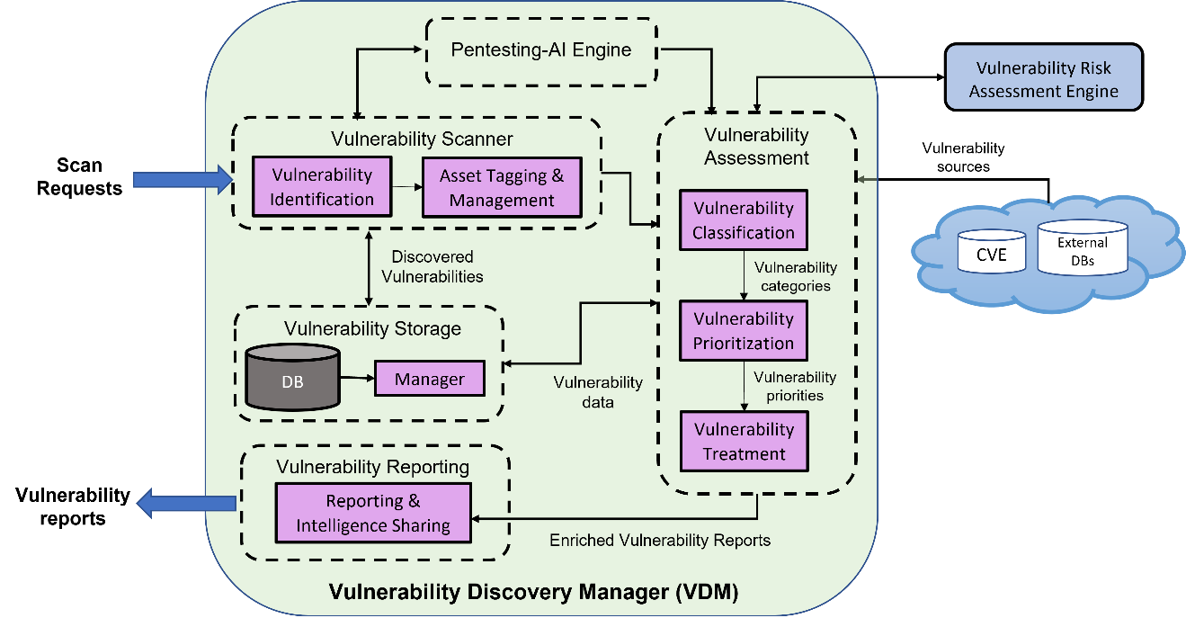
Vulnerability Discovery Manager
Architecture and main innovations
Main innovations:
Enrichment of the information included in the vulnerability reports with impact analysis for vulnerabilities affecting IoT and AI-based systems.
Integration of the vulnerability scanning tasks with a new AI-based component to automate penetration testing activities.
20

Slide 21
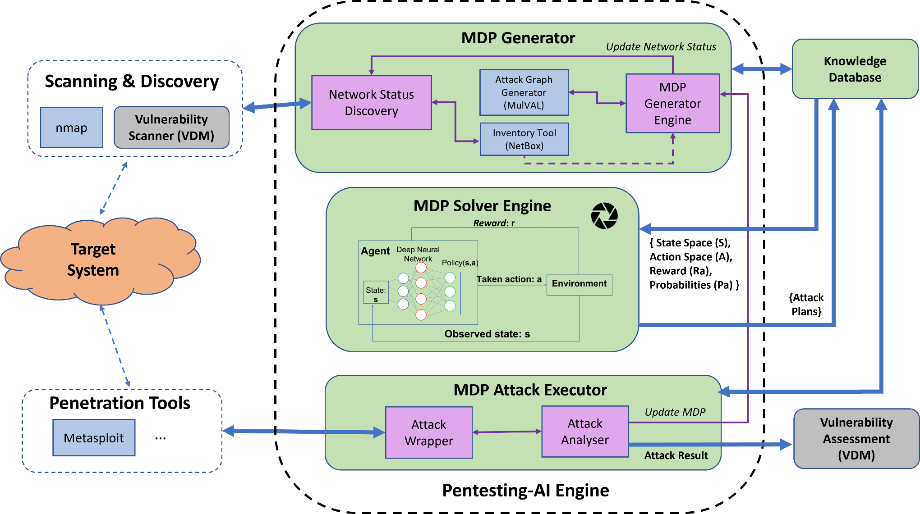
Vulnerability Discovery Manager
Pentesting-AI Engine architecture
21

Slide 22
PUC #1 Architecture and IRIS tools
ATA:
Nightwatch (CLS)
RRR (CLS)

Slide 23
Nightwatch & RRR: Presented by
IRIS PUC1 Demo
Barcelona, Spain, March 7th, 2024

Slide 24
Nightwatch: IRIS’s Cyber-Physical AI Anomaly Detection Tool
24
Notes:
24

Slide 25
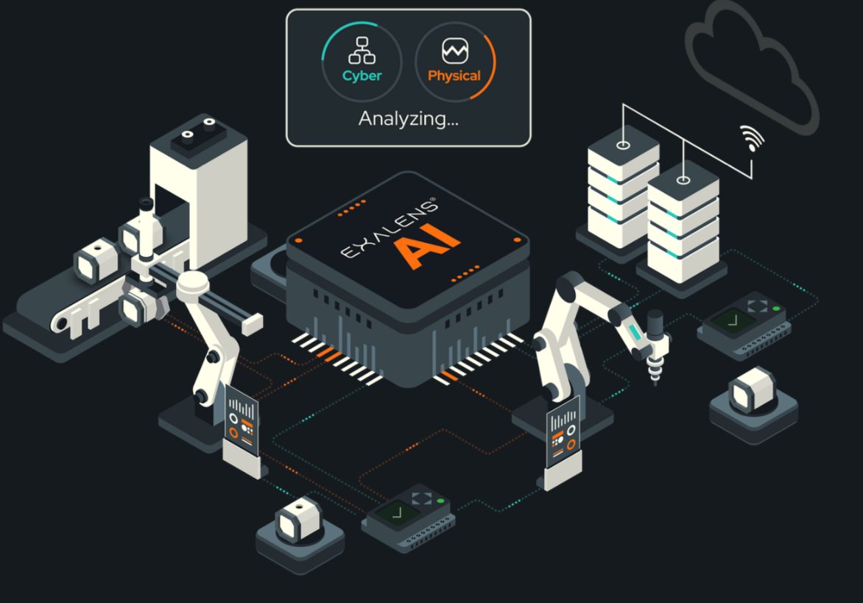
The Nightwatch Tool
Nightwatch is a by-product of the Exalens® Cyber-Physical AI platform that seamlessly unifies device, network, and physical process monitoring to automate root cause analysis, spot, and respond to cyber threats, system faults, and equipment failures in seconds.
Platform Features:
Network IQ Threat Detection & Asset intelligence
Process IQ AI-powered Process Anomaly Detection & Monitoring
Source IQ AI Analyst automating Root-Cause Analysis
Deployment methods:
On-Premise / Cloud / Hybrid
25
Notes:
25

Slide 26
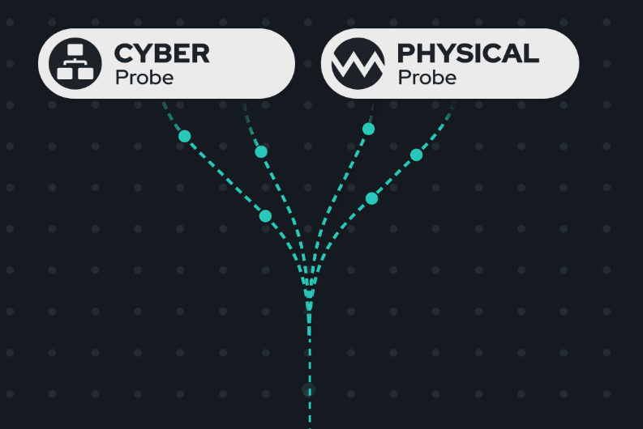
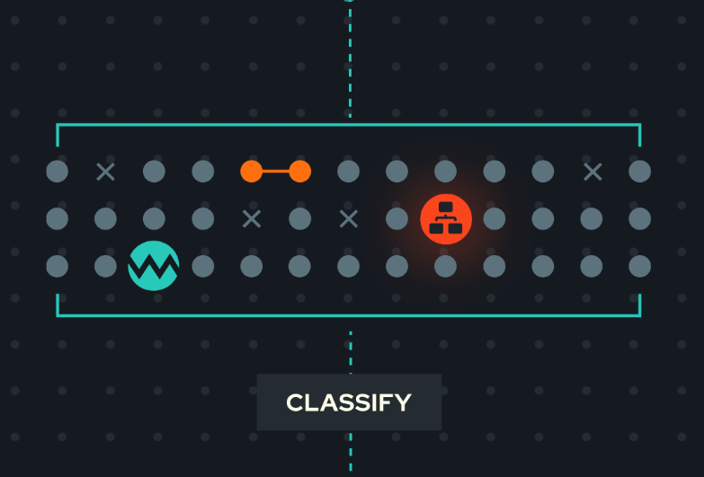
Key Innovations
Complete Visibility
Continuously track and profile device, application and network activity across your IT, IoT, and OT systems.
Securely upcycle physical machine and process data via native integration with existing operational systems – no infrastructure changes required.
Seamlessly, and securely, combine both cyber and physical process analysis within a single, agentless monitoring platform.
Smart Detection
Detect threats, vulnerabilities and anomalies in both device and physical process activity and track them as they evolve over time.
Autonomously analyse, assess and link related cyber and physical incidents across IT, IoT and OT systems in seconds.
Achieve low false positives and negatives with intelligent risk and threat classification, mapped to MITRE ATT&CK ICS.

Slide 27
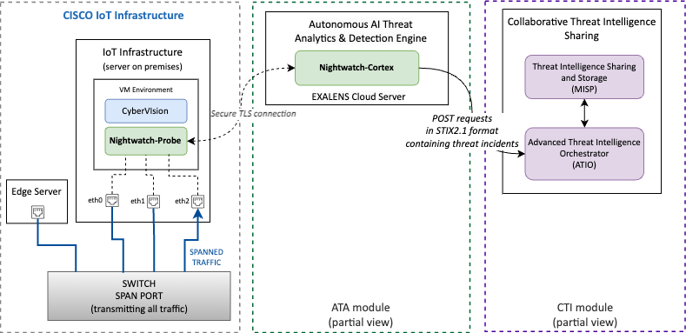
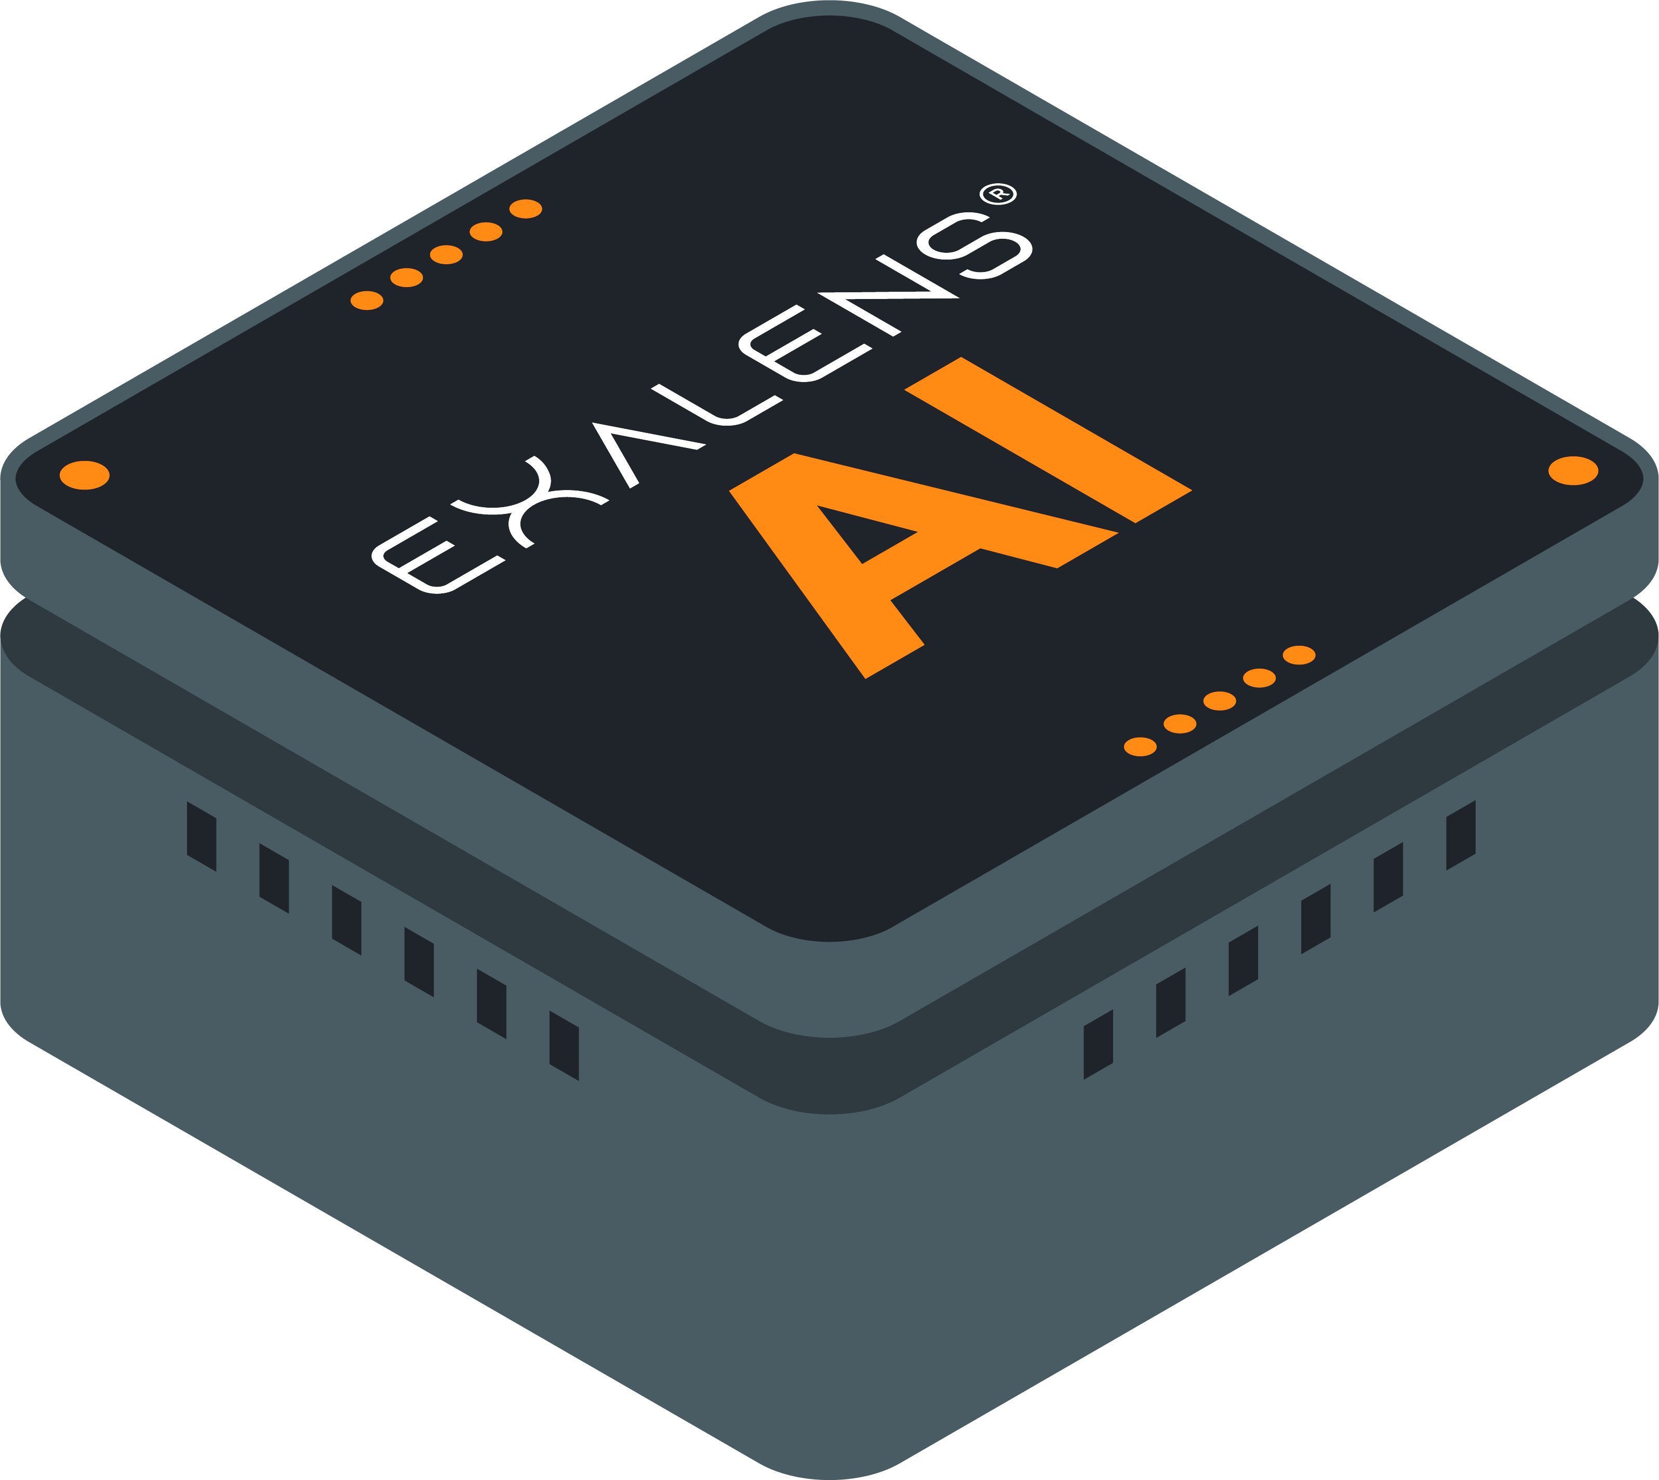
Nightwatch Architecture
Main components:
The Probe monitors the traffic from the devices, generates logs relative to the monitored endpoints, and collects data, and information relative to various network protocols.
The Cortex analyses and inspects the collected logs by seamlessly passing them to a detection mechanism composed by Nodes (collaborative fleet of detectors). Upon detecting an anomaly, the Cortex publishes incident alerts in JSON format to become visible to the IRIS end-users.
Data Processing
Data Sharing
Data Collection
Data Source
High-Level, Component-based Architecture of the Nightwatch tool

Slide 28
Supported Network (Cyber) Threat Detections
# | Detection Node | Protocol
1 | C2 Beacon Suspicious beaconing to {external/internal} host(s) | HTTP
 |  | TCP, UDP
 |  | SSL
2 | Network Scanning Unusual internal network scanning activity | TCP, UDP
 |  | ARP, ICMP
3 | Brute Force Suspicious number of failed login attempts in small time interval | SSH
 |  | FTP, HTTP
 |  | RDP
 |  | SMBv2
 |  | KRB
 |  | LDAP
 |  | NTLM
 |  | TELNET, VNC
4 | Network Flood Unusual number of consecutive connections with small interval | TCP
 |  | UDP
 |  | ICMP
5 | ARP Poison Suspicious unsolicited ARP messages ARP Unanswered Unanswered ARP requests | Suspicious ARP replies
 |  | Unanswered ARP requests
# | Detection Node | Protocol
6 | Discovery Suspicious discovery / enumeration activity | Network discovery
 |  | System accounts discovery
7 | Execution Remote service/ task creation Suspicious remote Service / Task creation | wmi_service
 |  | scheduled_task
8 | Impact Suspicious remote Shutdown / Reboot | System shutdown/reboot
9 | Defence Evasion Suspicious attempt to remotely clear Windows event logs | Remote windows event log removal
10 | Lateral Movement Suspicious file transfer over | OS Credential Dumping
 |  | Failed SMB connections
11 | Reconnaissance Path Enumeration detection | HTTP
 |  | HTTPS
12 | Credential Access LLMNR/NBNS session hijacking detection | NTLM
 |  | SMBv2
 |  | DNS

Slide 29
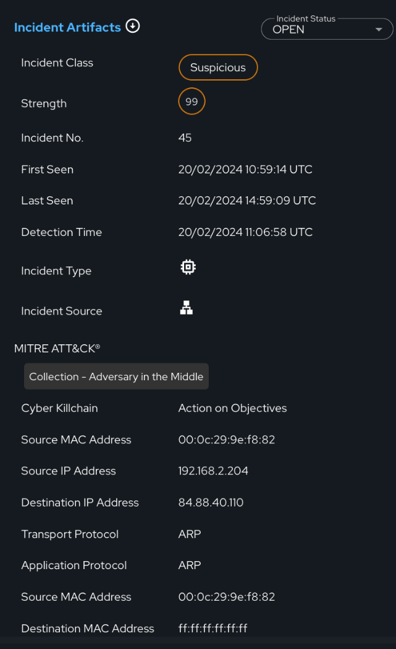
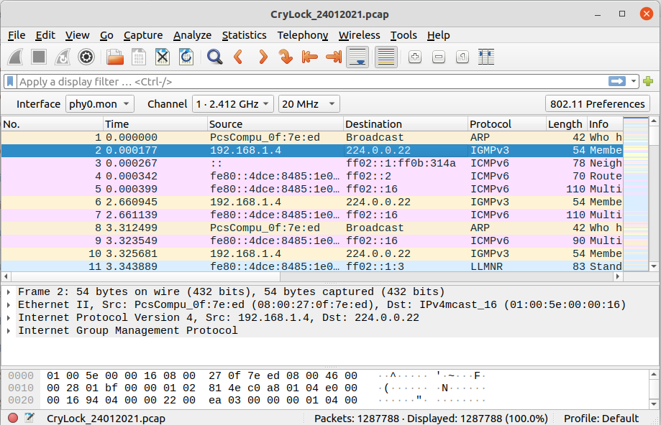
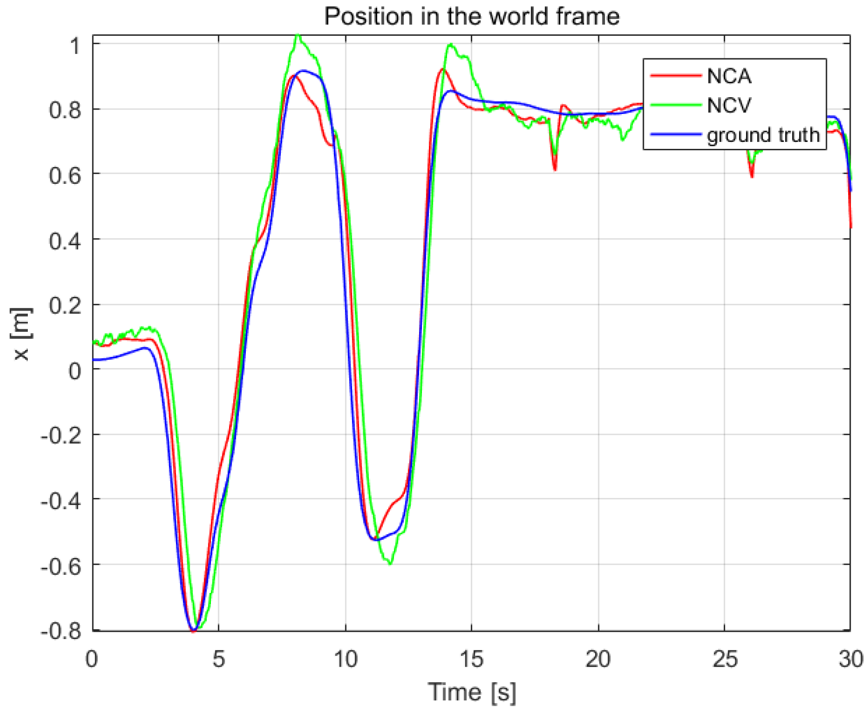
Input & Output Data
Network (cyber) data
.pcap files
physical interfaces (eth1, ...)
Network SPAN/TAP
Protocols accepted: TCP, UDP, ICMP, ARP, DNS, HTTP, SSL, etc.
Physical data
log files & streaming flows
.csv, .log, Redis, Kafka ingestion
M2M Protocols
Output data
Input Data

Slide 30
RRR: IRIS’s Risk-based Response & Self-Recovery Module
30
Notes:
30

Slide 31
The RRR Module
The Risk-based Response & self-Recovery (RRR) module of the IRIS platform is a risk-based decision-support framework underlying the IRIS Automated Threat Analytics (ATA) incident response and self-recovery procedures.
RRR leverages an array of optimization, and machine learning algorithms to evaluate the incident data and dynamically formulate the optimal Course of Action (CoA) concerning a detected incident.
RRR builds upon innovations in Security Orchestration, Automation, and Response (SOAR) as well as in threat intelligence execution.
It includes a self-recovery mechanism that adapts a programmable API to implement remediation actions without the need for human intervention.
Despite its automation prowess, within IRIS, human oversight is paramount. Accordingly, RRR’s decision-support framework is supervised by policies defined by CERT/CSIRT operators and enacted through the IRIS EME Dashboard.
Security Incident Response Platforms
Security Orchestration & Automation
Threat Intelligence Platforms
31
Notes:
31

Slide 32
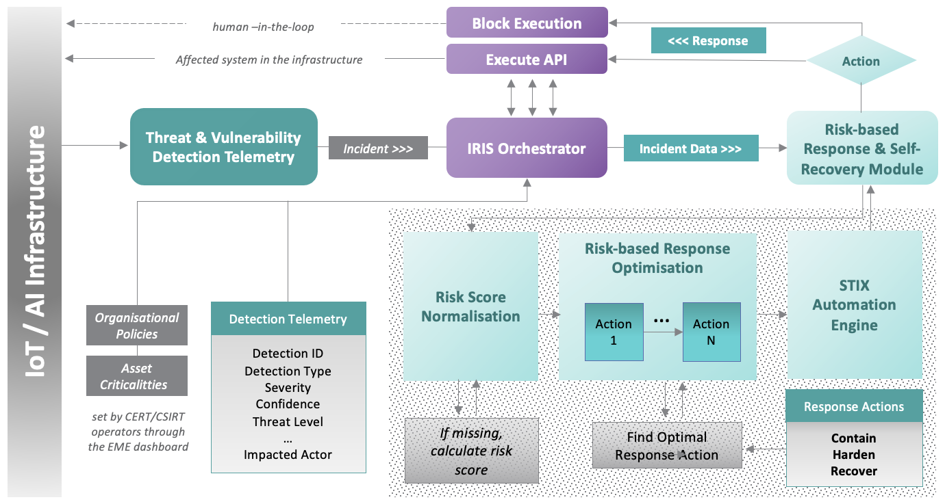
RRR Architecture
Main Components:
Risk score normalization engine: it normalizes the incident data transforming values into anticipated data types and scales to facilitate risk-based response.
Optimization engine: it selects optimal response action(s) to a detected incident by employing optimization and ML algorithms.
STIX automation engine: it shares the selected incident response workflow in the form of STIX-CACAO playbooks enabling the seamless exchange of threat intelligence with security platforms, like MISP.
RRR’s Reference Architecture
32

Slide 33
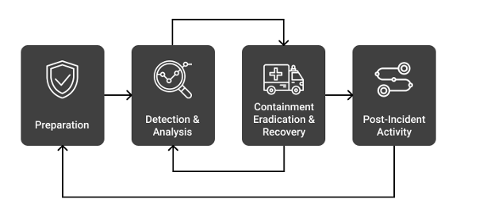
Incident Response Methodology
Compliance with NIST
RRR’s incident response methodology is in line with the NIST framework for incident handling described in the Computer Security Incident Handling Guide (NIST SP 800-61).
Post Incident Activity
Containment, Eradication & Recovery
Detection & Analysis
Preparation
The NIST Incident Response LifeCycle
RRR’s Incident Response Methodology
33

Slide 34
Input & Output Data
Compliance with STIX-CACAO
Output data
"playbook_actions": {
"type": "playbook",
"playbook_id": "",
"spec_version": "cacao-2.0",
"playbook_standard": "CACAO",
"name": "playbook name",
"playbook_valid_from": ”…",
"playbook_valid_until": ”…..",
"organization_type": "Org1",
"asset": "192.168.2.200",
"risk_score": "59.0",
"playbook_impact": "79.0",
"playbook_severity": "79.0",
"playbook_priority": "79.0",
"playbook_type": "detection",
"workflow_start": "3",
"workflow": [
{
"id": 2,
"impacted_actor": "10.0.1.1",
"action": "Isolate Host",
"description": "It is recommended that …",
"execution_api": ”isolate_host()",
"action_impact": 10
},
]
}
CACAO playbook
"detection": {
"organisation": "Org1",
"detection_name": "Suspicious Unknown beaconing to External host",
"detection_summary": "192.168.2.50 was observed making suspicious beaconing ….",
"source": "Nightwatch",
"classification": "THREAT_BEHAVIOUR",
"first_seen": "1678150861.979507",
"last_seen": "1678151643.938273",
"actor": "192.168.2.50",
"confidence": "0.999999999",
"risk_score": "79",
"severity":"4.3",
"threat": ”high",
"iris_id": 782
},
Detection Telemetry
Input Data
“policies": {
"organisation": "Org1",
"action_policy": {
"contain": {
"isolate": "enabled",
"block_service": "enabled",
"shutdown": "enabled"
},
"harden": {
"install_patches": "enabled",
"disable_service": "enabled",
"implement_access_control": "enabled"
},
"recover": {
"restore": "enabled",
"reconfigure": "enabled"
}
}
}
Policies
"criticalities": {
"organisation": "Org1",
"asset_ip": "192.168.2.50",
"asset_device": "Kali",
"criticality": "2"
}
Asset Criticalities
34

Slide 35
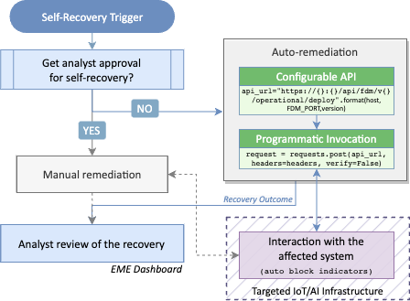
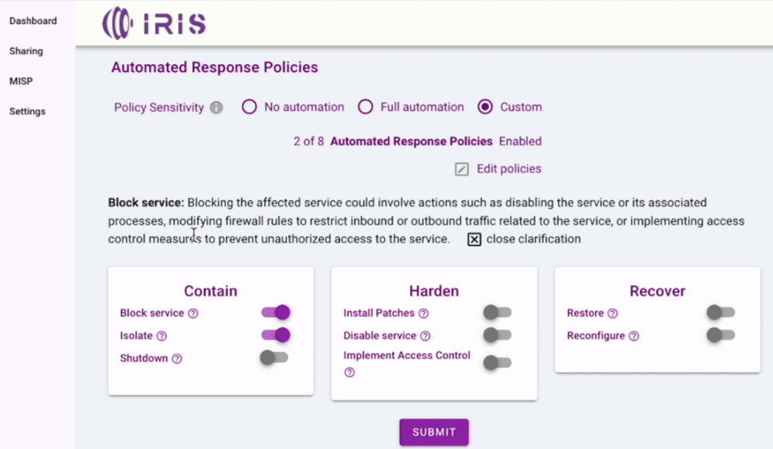
Self-Recovery Mechanism
Key aspects:
RRR integrates a programmable API connecting seamlessly with external APIs to effect remediation actions without the need for human intervention.
Organisation-specific automation policies determine whether the response and recovery workflow will automatically be enacted or will require review & approval from the critical infrastructure operator.
IRIS-Enhanced MeliCERTes Ecosystem
RRR’s self-recovery process
35

Slide 36
PUC #1 Architecture and IRIS tools
CTI:
ATIO (ICCS)

Slide 37
Advanced Threat Intelligent Orchestrator (ATIO)
ICCS
PUC1| 07/03/2024

Slide 38
Adhering to SOAR capabilities
Streamline operations
ATIO/SOAR
Tools
Sharing
Full stack Middleware
Input
Output
User
Response

Slide 39
Advanced Threat Intelligence Orchestrator (ATIO) introduction
Advanced Threat Intelligence Orchestrator (ATIO) - Full stack Service Middleware

Slide 40
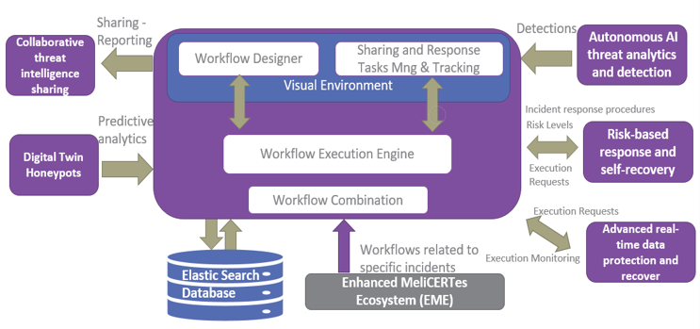
Advanced Threat Intelligence Orchestrator (ATIO) Structure
Back end and Front end Services
Orchestration Workflow Manager (OWM)
Sharing and Response Task Management and Tracking
Workflow Execution Engine
Workflow Combination
Data Exchange Framework
Command Execution Requests Framework
ATIO database

Slide 41
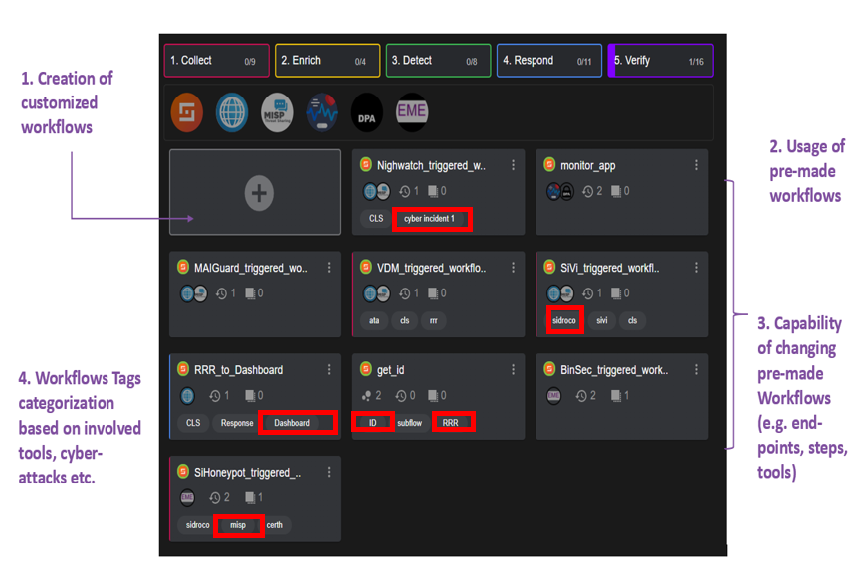
Orchestrator (ATIO) Workflow Designer (OWM)

Slide 42
Terminology of Workflow execution through Shuffle environment
Automatic end-to end workflow execution and interpretation
Manual initiation of a workflow
Workflow steps
Arrows
Action steps (processing)
Subflows

Slide 43
Backend ATIO Functionalities
Listens to 9 end-points and push to 3 end-points
Creation and provision of 9 OpenAPIs interfaces until now
ATIO aggregates multiple flows to one direction (e.g. event detection originating from the infrastructure into a single point).
Modifies the events by transforming from one format to another format.
Filters the information.
Transforms STIX2.1 format to a MISP event object in order to be inserted in the MISP database.
Records all the additions, changes and deletions of an end-user-oriented workflow.
Forwards these events to the appropriate modules that are required for event storage, analysis, enrichment, risk and response calculation, as well as user-friendly presentation and auditor backlog.
Efficient routing

Slide 44
PUC #1 Architecture and IRIS tools
CTI:
CTI Sharing and Storage (CERTH)

Slide 45
Collaborative Threat Intelligence Sharing and Storage
Eleni Darra | CERTH

Slide 46
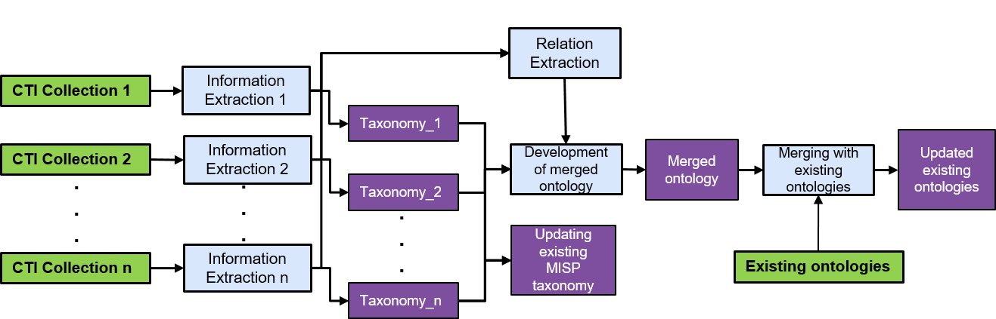
The role of CTI in the IRIS platform
CTI Collection
Information Extraction
Taxonomy generation
Update existing MISP taxonomy
Development of merged ontology
Merging with existing ontologies
Updated existing ontologies

Slide 47
Taxonomy generation
Develop a common lexicon with the end goal of setting standards and best practices for managing the cybersecurity of ICT systems against attackers

Slide 48
List of taxonomies in MISP

Slide 49
Update MISP

Slide 50
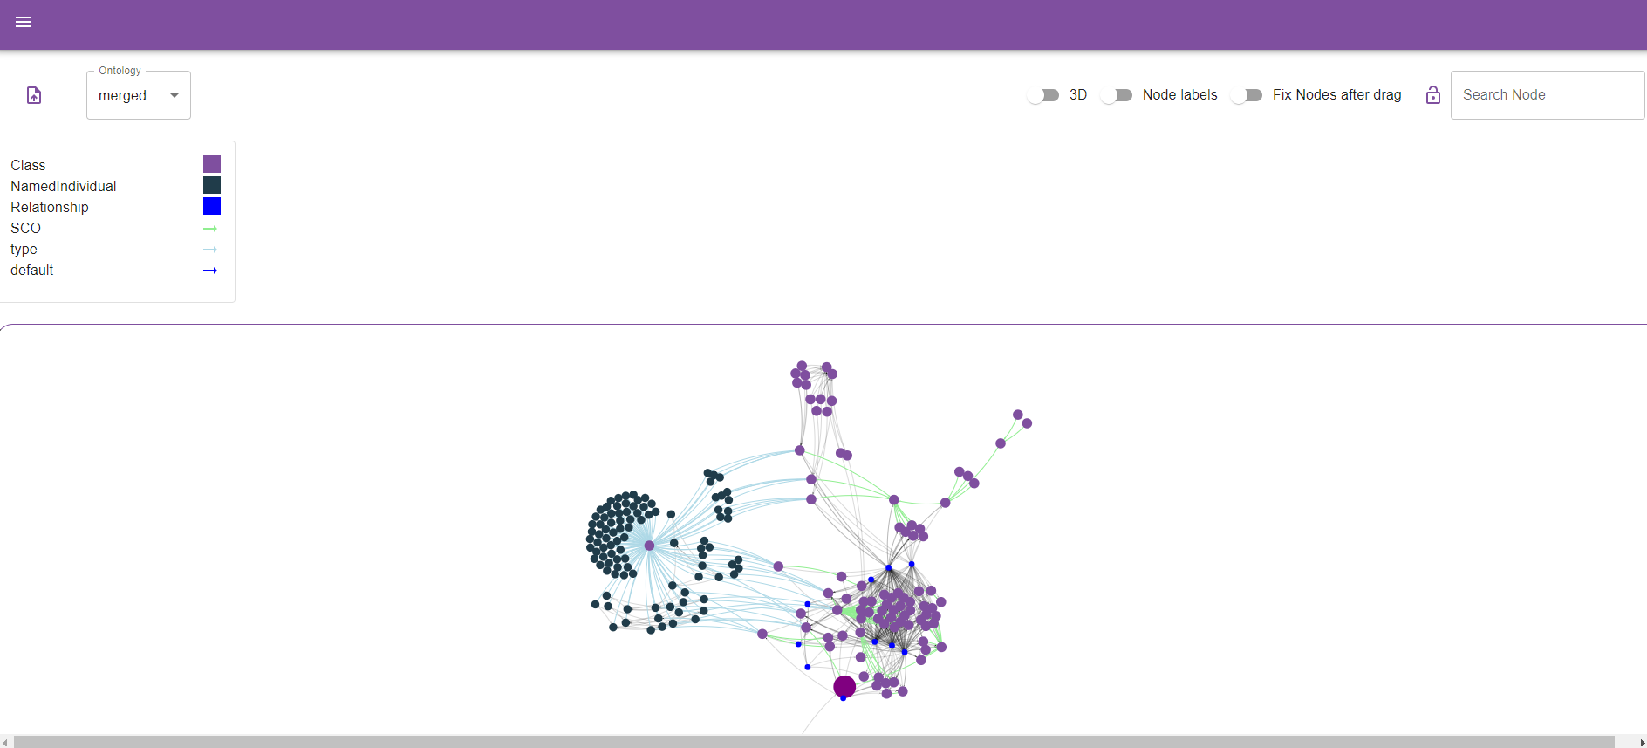
Ontology visualization environment

Slide 51
Ontology generation
Ontology generation from internal sources
Ontology generated from different external sources

Slide 52
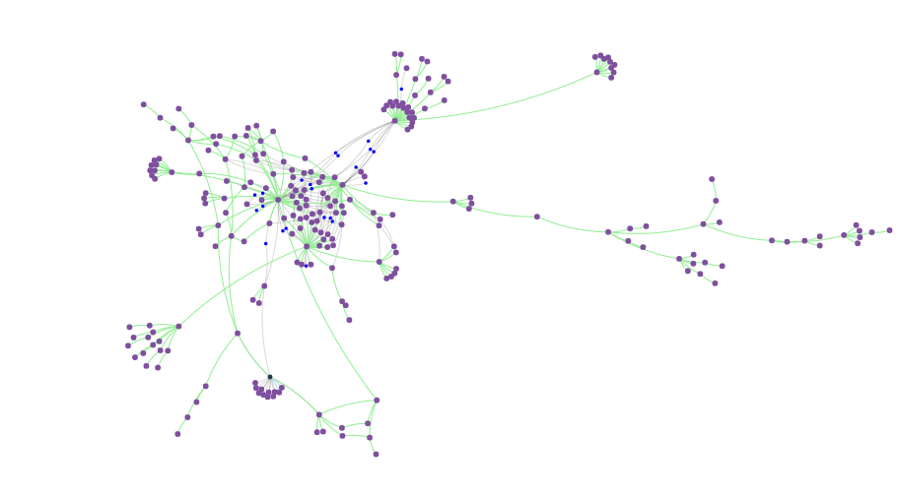
Ontologies’ update
MALOnt update
IoTSec updated

Slide 53
PUC #1 Architecture and IRIS tools
EME:
Enhanced MeliCERTes Ecosystem (INTRA)

Slide 54
IRIS-enhanced MeliCERTes Ecosystem
Netcompany – Intrasoft
Dimitrios Skias, M.Sc, dimitrios.skias@netcompany-intrasoft.com
Dr. Sofia Tsekeridou, sofia.tsekeridou@netcompany-Intrasoft.com

Slide 55
IRIS-enhanced MeliCERTes Ecosystem
Key objectives: Extend MeliCERTes v2 open-source platform incorporating IRIS CTI developments to enable:
Secure and efficient security information representation in standardized format
Secure disclosable AI-relevant CTI information sharing
Promote wider awareness, better preparation, detection and response capabilities
Define sharing policies and communities of trust
Securely communicate and collaborate with CERT/CSIRT authorities

Slide 56
IRIS-enhanced MeliCERTes Ecosystem
Secure storage and augmentation of the AI focused cybersecurity knowledge base at a European level
Provision of advanced and unified dashboard for incident reporting & situational awareness
Offering Authentication and Authorization AAA services
Keycloak IMS
Distributed architecture – ecosystem
Instances deployed at stakeholders’ premises

Slide 57
MeliCERTes v2 – Cerebrate

Slide 58
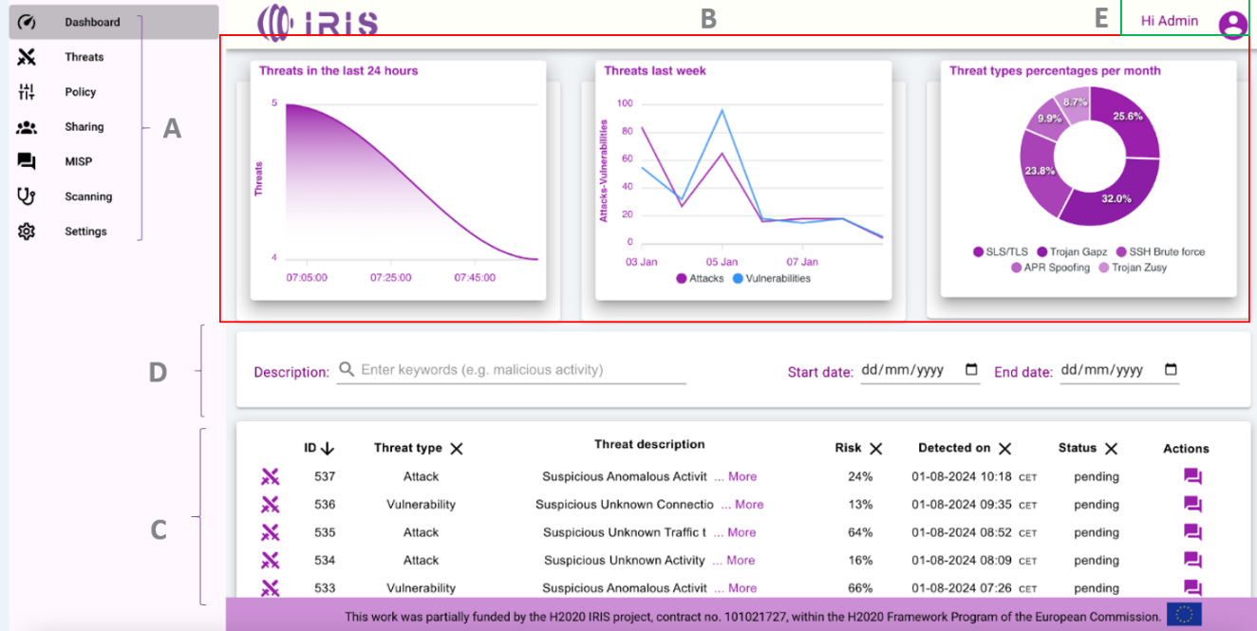
EME – CI operator view

Slide 59
EME – Automated response Policy management

Slide 60
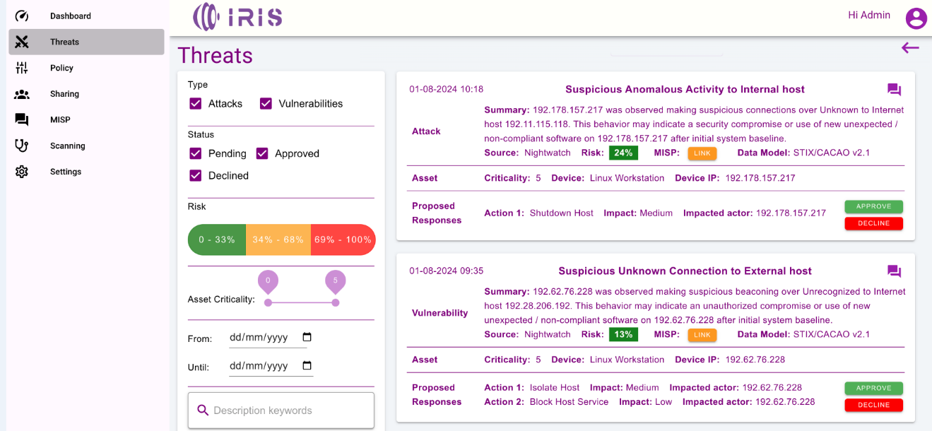
EME – CI Operator Attacks view

Slide 61
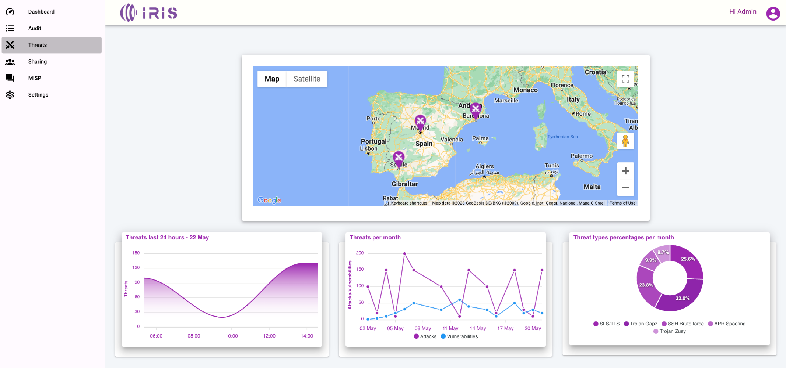
EME – CERT/CSIRT authority view

Slide 62
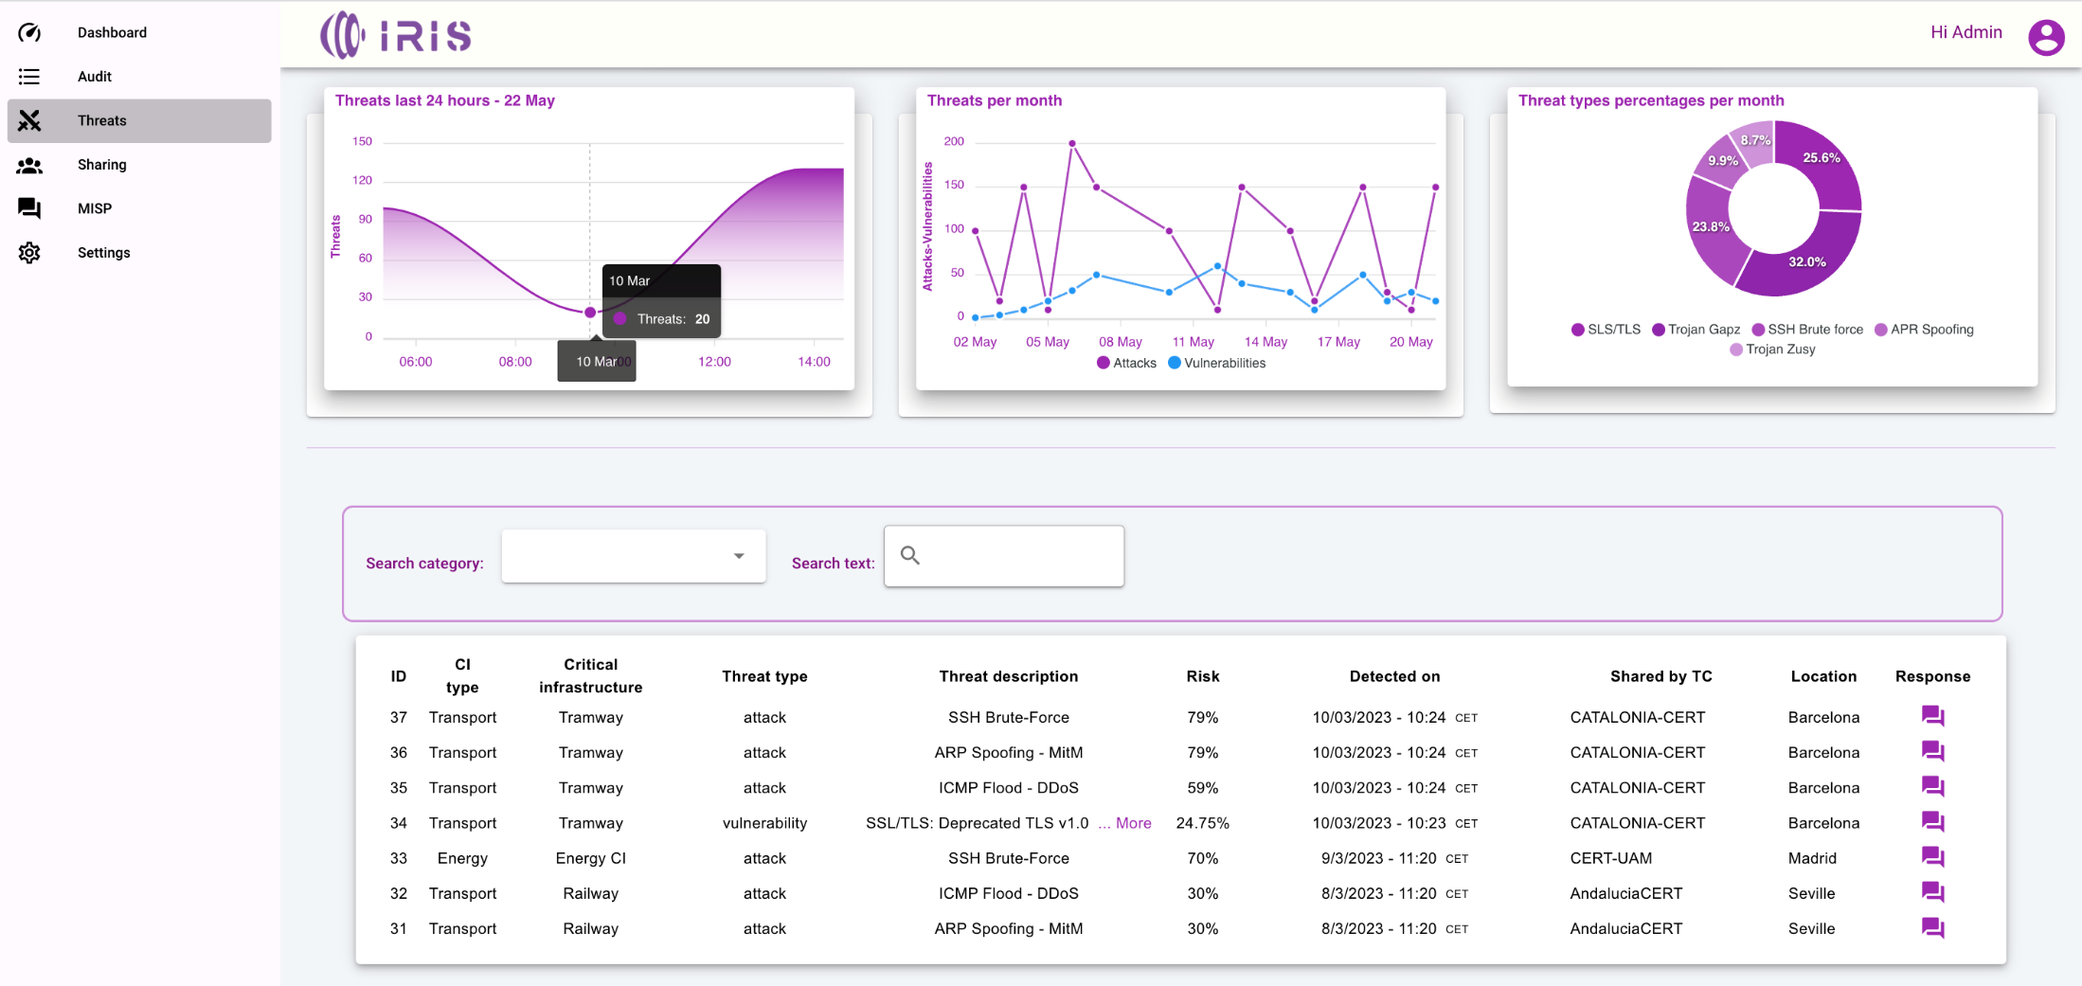
EME – CERT/CSIRT authority view

Slide 63
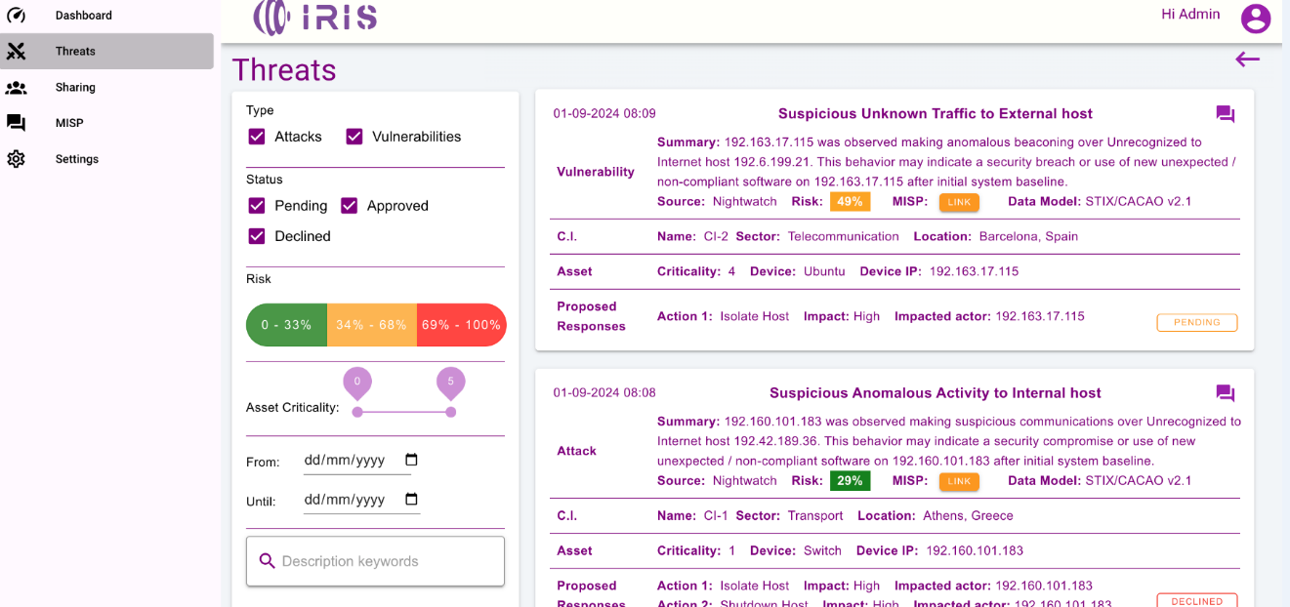
EME – CERT/CSIRT authority view

Slide 64
IRIS PUC 1 – User Story 1
Xavier Azemar / Cisco
René Serral / UPC
Susana González / Eviden
Héctor Godoy / UPC

Slide 65
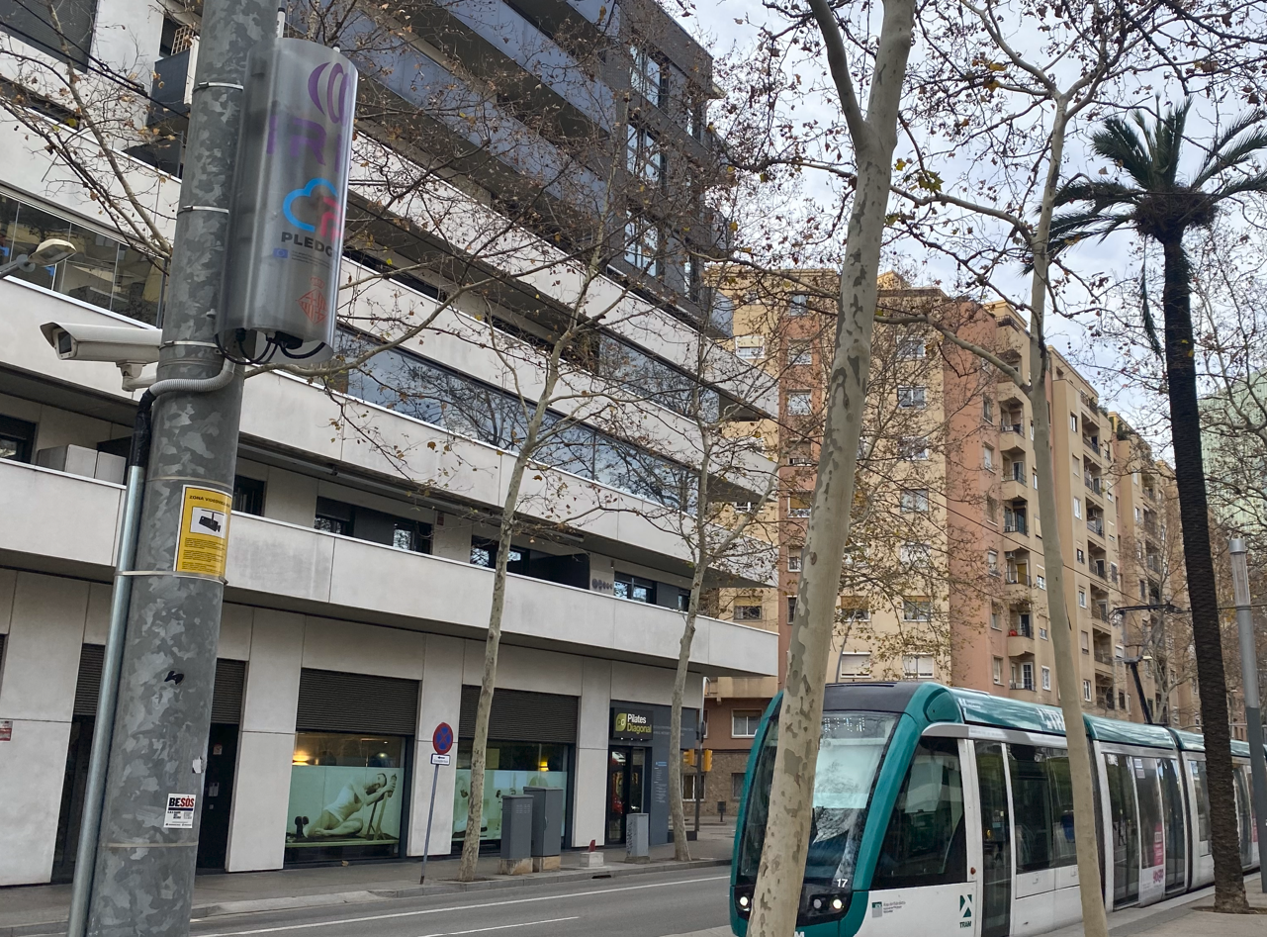
IRIS User Stories PUC-1
The goal of IRIS PUC 1 is to provide an environment to validate the capabilities of the IRIS platform in ensuring the operation of Barcelona's tram IoT network, (used for detecting users risk situations), against cyberattacks and vulnerabilities, with the ultimate goal of ensuring the safety of users.
We will demonstrate
Scanning vulnerabilities of new devices in the IoT network – (User story 1)
Detection of cybersecurity attacks – (User story 2)

Slide 66
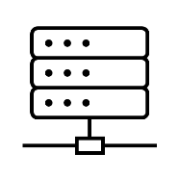
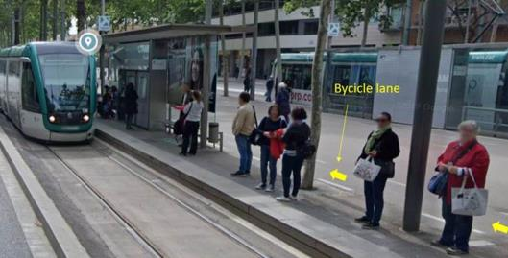
User Story 1: New device is connected in the network and will be scanned for vulnerabilities Why is important to scan vulnerabilities:
Unauthorized Access: Hackers can control the IoT devices and access the transport network.
Data Breach: Sensitive information can be stolen.
Man-in-the-Middle Attacks: Communication can be intercepted.
Device Manipulation: The device's operations can be altered, potentially causing disruptions.
Denial-of-Service Attacks: The device can be overwhelmed with traffic, making it inoperative.
Physical Damage: vulnerabilities can lead to users damage.

Slide 67
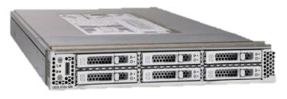
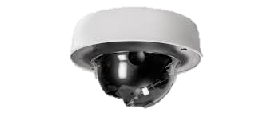
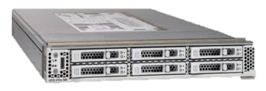
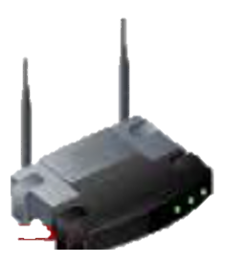
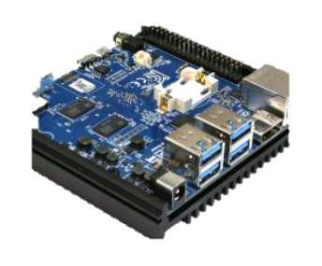
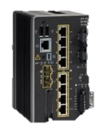
IRIS – PUC 1 – Infrastructure
UCS Server
Internet
Datacenter “Ca l’Alier”
IRIS Tools
<
VDM – NitghtWatch
ATIO – RRR - EME
Camera - Tram
Camera - Diagonal
Ambient –
Sensor
UPC - Ubuntu
Cybervision
Other VMs
Firewall IMI
Firewall 2
Switch
Sensor
IC3000 #2
Pledger Edge Server
Tram Station “DIAGONAL”
Tram Station “TRAM”
OMEGA DC @i2CAT – PLEDGER PROJECT
Pledger Kubernetes @i2CAT
i2CAT Monitoring
Sensor
IC-3000 #1
Switch
IE3200 #2
K8s Master VM
Openstack
Switch
IE3200 #1
K8s Worker#1
Openstack
K8s Worker#2
Openstack
K8s Worker#3
Openstack
Switch
IE3200 #1
RSU #1
802.11p
Computing
ODROID #1
Switch
IE3200 #2
RSU #2
802.11p
Computing
ODROID #2
Notes:
67

Slide 68
User Story 1: Demo: New device is connected in the network and will be scanned for vulnerabilities New Device: Maintenance Operator of IoT devices
DataCenter
Bastion Host

Slide 69
IRIS – PUC 1 – Infrastructure User Story 1
UCS Server
Internet
Datacenter “Ca l’Alier”
IRIS Tools
<
VDM – NitghtWatch
ATIO – RRR - EME
Camera - Tram
Camera - Diagonal
Ambient –
Sensor
UPC - Ubuntu
Cybervision
Bastion Host
Firewall IMI
Firewall 2
Switch
Sensor
IC3000 #2
Pledger Edge Server
Tram Station “DIAGONAL”
Tram Station “TRAM”
OMEGA DC @i2CAT – PLEDGER PROJECT
Pledger Kubernetes @i2CAT
i2CAT Monitoring
Sensor
IC-3000 #1
Switch
IE3200 #2
K8s Master VM
Openstack
Switch
IE3200 #1
K8s Worker#1
Openstack
K8s Worker#2
Openstack
K8s Worker#3
Openstack
Switch
IE3200 #1
RSU #1
802.11p
Computing
ODROID #1
Switch
IE3200 #2
RSU #2
802.11p
Computing
ODROID #2
Notes:
69

Slide 70
User Story 1: New device is connected in the network and will be scanned for vulnerabilities – Summary IRIS Benefits
Ensure User safety
Vulnerabilities in public the tram IoT / control systems can be exploited to cause disruptions and hazard situations.
But also
Data Protection: Public transport systems may handle sensitive data, including payment information and personal data of passengers. By Identifying vulnerabilities IRIS helps protect this data from breaches that could lead to identity theft or fraud.
Maintaining Public Trust: If a vulnerability is exploited and leads to a security incident, the public's trust in the transportation system could be undermined.

Slide 71
User story 1 Functional Workflow
PUC1| 07/03/2024

Slide 72
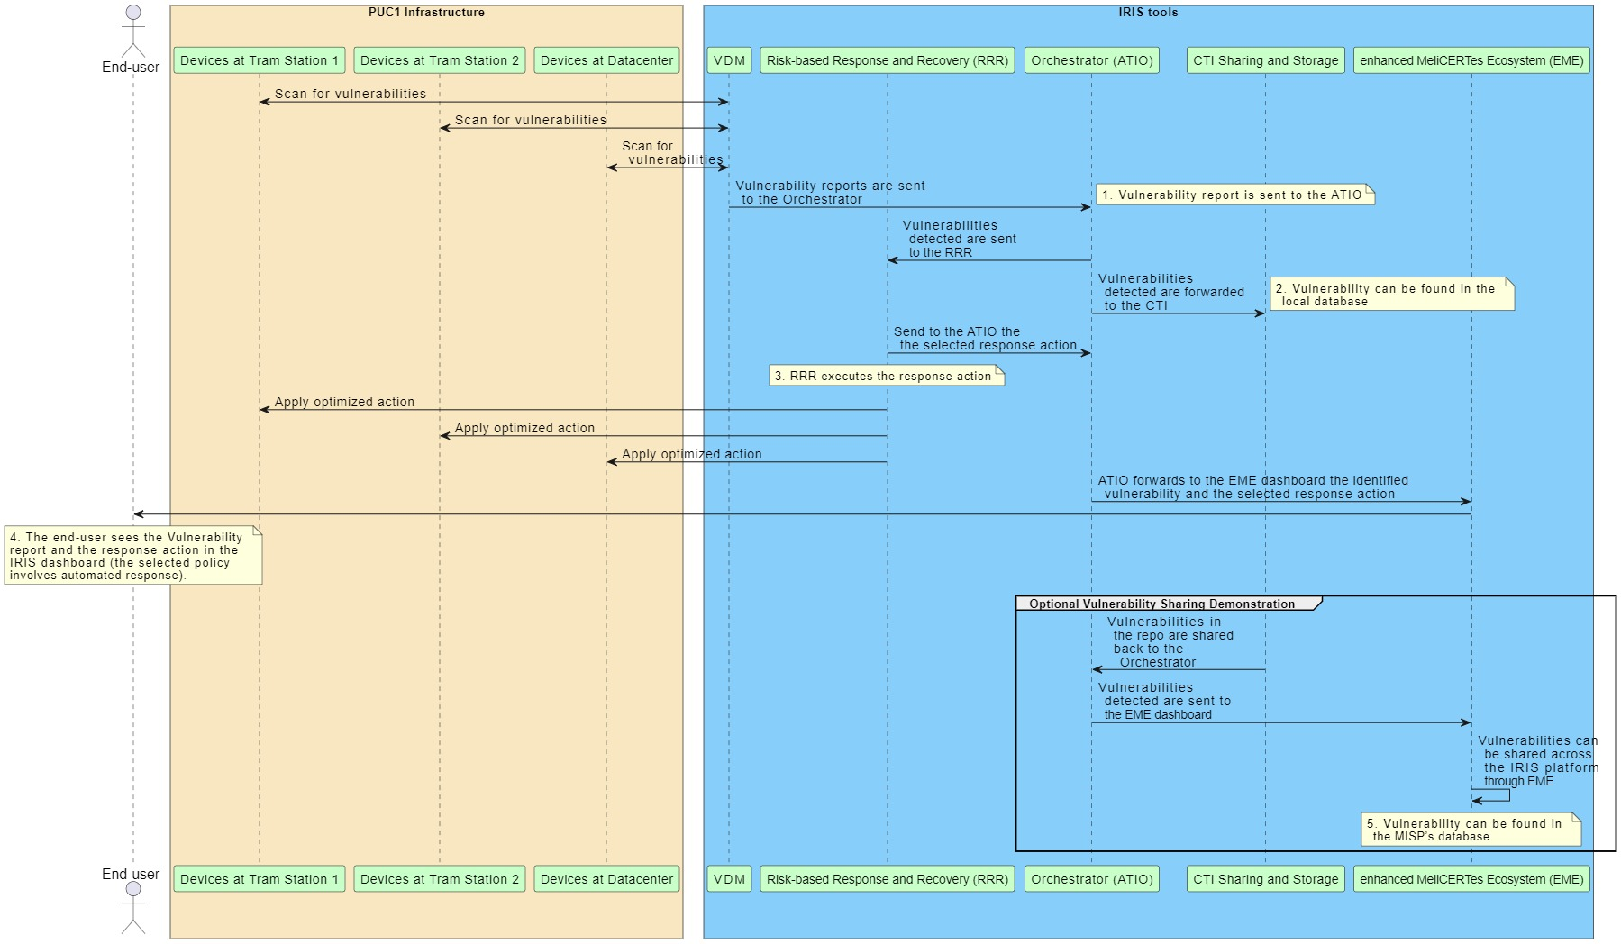
VDM Functional Workflow

Slide 73
User story 1 Orchestrator Workflows
PUC1| 07/03/2024

Slide 74
Workflow Categories and Scenario 1
IRIS workflows categories are five (5) and can be found below:
Cyber incident detection Workflow
Threat response Workflow
Incident recovery Workflow
Sharing Workflow
Reporting Workflow
Simultaneously and sequential workflows execution

Slide 75
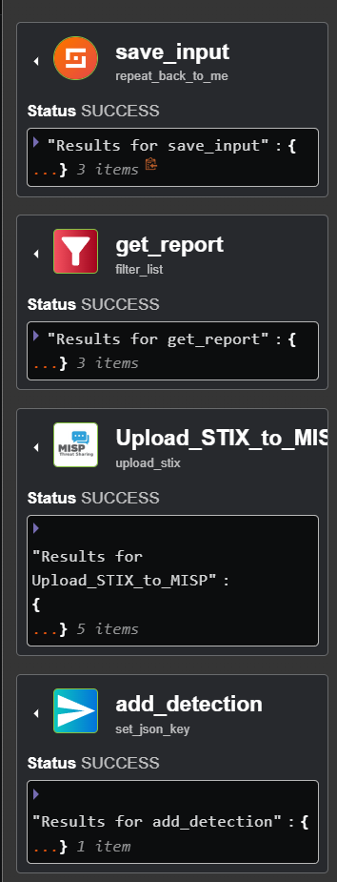
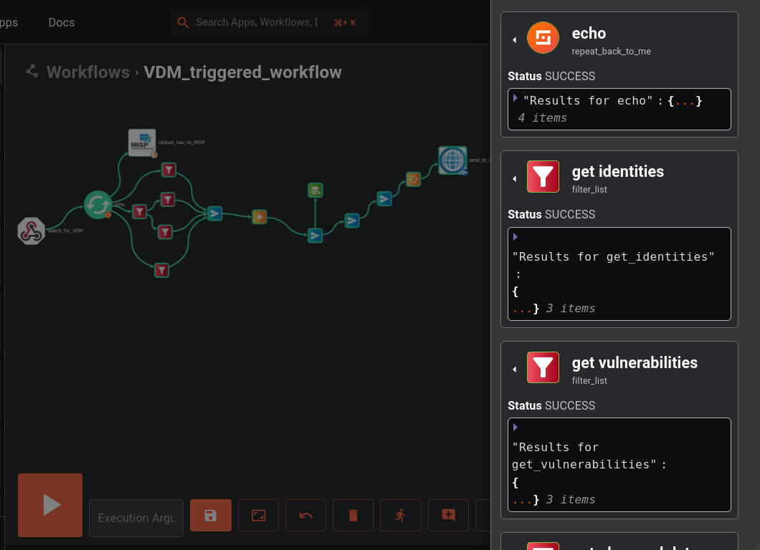
Action bar and status of execution steps

Slide 76
VDM triggered workflow

Slide 77
Sub-flow RRR triggered workflow

Slide 78
IRIS PUC 1 – User Story 2
Xavier Azemar / Cisco
René Serral / UPC
Susana González / Eviden
Héctor Godoy / UPC

Slide 79
User Story 2: Detection of cybersecurity attacks Why is it important to detect cybersecurity attacks?
Guaranteeing the security of pedestrians, commuters and population in general is of paramount importance
PUC 1 aims at avoiding hazard situations in the tramway station
This requires prompt and near real-time response
As a consequence, early detection of cybersecurity attacks is critical

Slide 80
User Story Benefits
On common and highly disruptive attack is (D)DoS
Where the attacker overloads the services preventing normal operation
Consequently potentially generating a hazard situation

Slide 81
Benefits of deploying IRIS
In this scenario IRIS provides a more solid environment
Preventing the attack before its impact is too relevant
Thus, allowing normal operation
Even in adverse situations where an attacker aims at disrupting the service

Slide 82
Step by step attack detection
Attacker starts the DoS attack by flooding the network and targeting the service
Nightwatch, while monitoring the network detects the increase of traffic
When detected, the system informs ATIO about the situation
ATIO informs EME

Slide 83
IRIS – PUC 1 – Infrastructure User Story 2
UCS Server
Internet
Datacenter “Ca l’Alier”
IRIS Tools
<
VDM – NitghtWatch
ATIO – RRR - EME
Camera - Tram
Camera - Diagonal
Ambient –
Sensor
UPC - Ubuntu
Cybervision
Other VMs
Firewall IMI
Firewall 2
Switch
Sensor
IC3000 #2
Pledger Edge Server
DoS Attack
Tram Station “DIAGONAL”
Tram Station “TRAM”
OMEGA DC @i2CAT – PLEDGER PROJECT
Pledger Kubernetes @i2CAT
i2CAT Monitoring
Sensor
IC-3000 #1
Switch
IE3200 #2
K8s Master VM
Openstack
Switch
IE3200 #1
K8s Worker#1
Openstack
K8s Worker#2
Openstack
K8s Worker#3
Openstack
Switch
IE3200 #1
RSU #1
802.11p
Computing
ODROID #1
Switch
IE3200 #2
RSU #2
802.11p
Computing
ODROID #2
Notes:
83

Slide 84
User story 2 Functional Workflow
PUC1| 07/03/2024

Slide 85
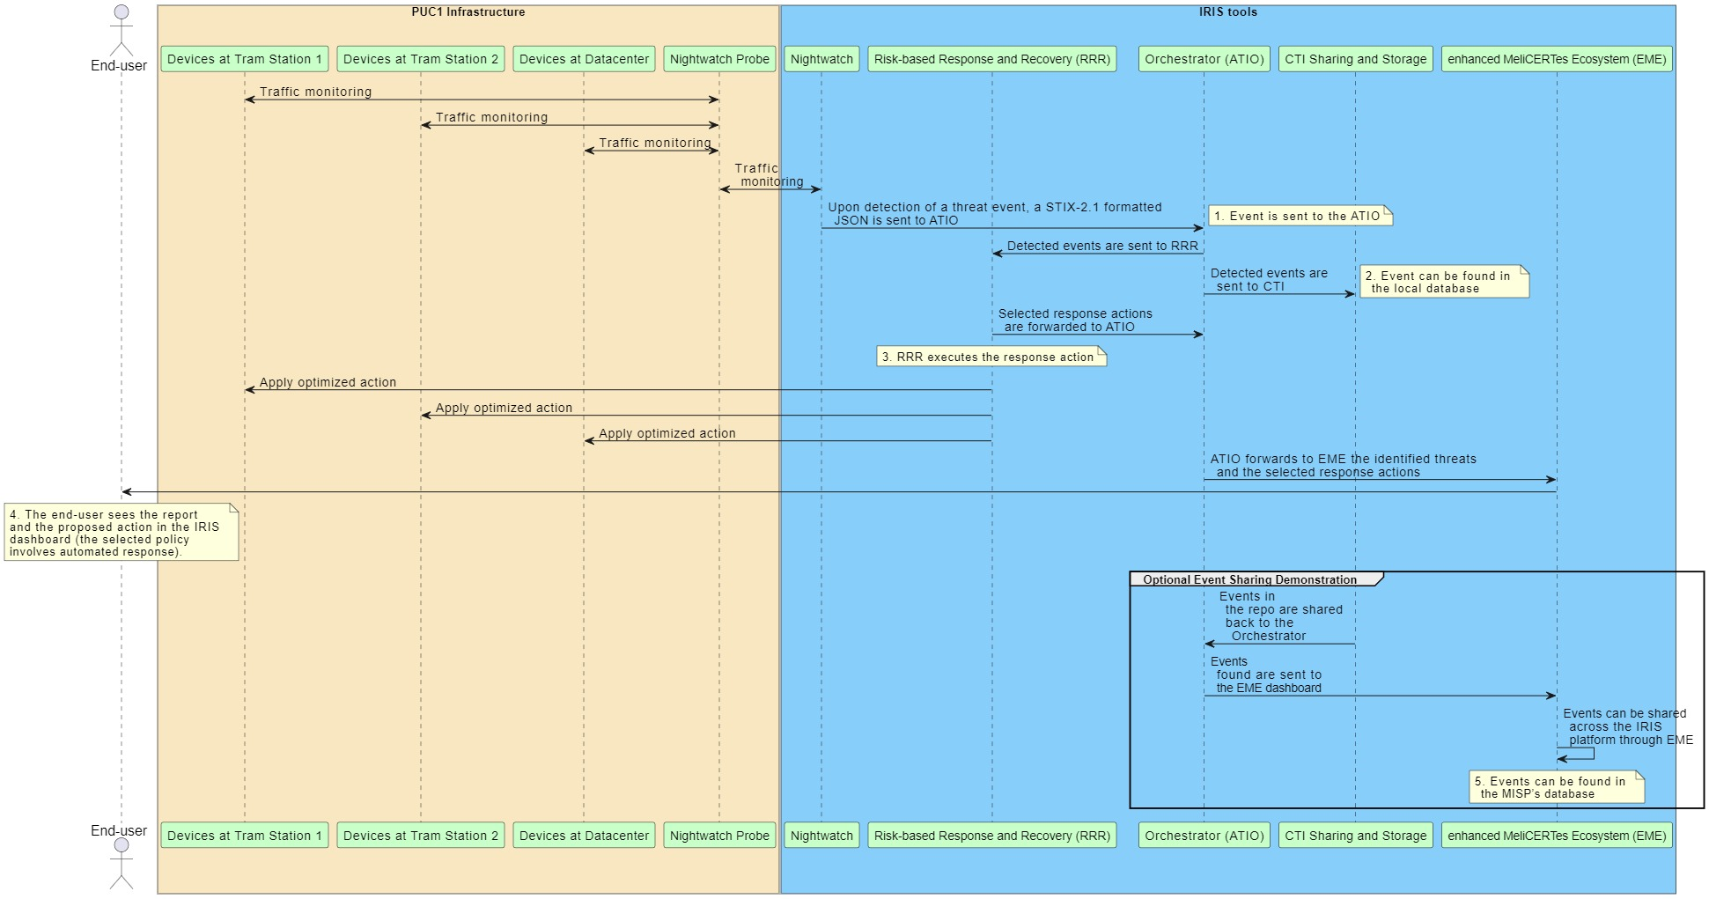
Nightwatch Functional Workflow

Slide 86
User story 2 Orchestrator workflows
PUC1| 07/03/2024

Slide 87
Workflow Categories and Scenario 2
IRIS workflows categories are five (5) and can be found below:
Cyber incident detection Workflow
Threat response Workflow
Incident recovery Workflow
Sharing Workflow
Reporting Workflow
Simultaneously and sequential workflows execution

Slide 88
Action bar and status of execution steps

Slide 89
NIGHTWATCH triggered workflow

Slide 90
Sub-flow RRR triggered workflow

Slide 91
Social Acceptance Assessment
This session is also part of our research on the social acceptance of IRIS project
The aim is to get a feedback on the demonstration based on your perceptions
First you will see the demonstrations then you will participate in a survey and then in a small focus group

Slide 92
Social Acceptance of Technology IRIS model
BASED ON 3 PRINCIPLES
Human centredness,
Leave no one behind
Ethics-by-design
WHO: Smart Urban Transport stakeholders to assess the IRIS technology
WHAT: perceptions on the IRIS Platform.
HOW: demos + survey + discussion group to assess different dimensions of social acceptance
Notes:
We focus on social acceptance because it has become clear that the acceptance of innovation is not only due to technical features of a product or of a solution but also to other variables such as behavior, opinions, awareness, attitudes and beliefs.
At cybersecurity Lab we elaborated a model to assess Social Acceptance at different stages of the research and design process.
CyberEthics Lab. developed a methodology to assess social acceptance of technology SAT (Occhipinti et al. 2022) which takes social acceptance as a function of user experience, combined with perceived disruptiveness of the technical solution, its impact on values and trustworthiness.
Out model is based on three principles: We take the social acceptance of a solution as a function of four components, called bubbles.
SAT can be applied not only with end-users but also with other stake holders
SO today you are the experts we would like to assess the iris technology, and we are interested in your expectations perception… we will conduct this focus groups and then ask you to fill in a survey.

Slide 93
Value
Our own values provide us with some form of orientation on how to behave.
Values are embedded in technology
Values are spread throughout society
Value as something good and desirable
Notes:
The notion of value that we use is the following:
Value embodies the idea of something good and desirable.
Our own values provide us with some form of orientation on how to behave. We live, we work according to certain values. We struggle when we have to behave in a way that doesn’t comply with the values that are important for us. Values are individual, but they are social as well. They depend on our social life, our family, our education, our political views, the country we were raised in, the people we interact with along our daily life, our career, our position in society, our political, religious and moral standing.

Slide 94
Indicators
UX
Usefulness
Perceived Ease of Use
Likeability
Reliability
Value Impact
Perceived Behaviour Control
Perceived Autonomy
Capacity Enabling

Slide 95
Indicators
TRUST
Transparency
Perceived Certainty
Perceived risk
Institutional trustworthiness
Social Disruptiveness
Perceived disruptiveness

Slide 96
First step…
Social Acceptance Survey
Direct Link or QR code to Google form
https://docs.google.com/forms/d/e/1FAIpQLSchevleO9hOw5NZ5z-VEzItpkWCiO2Eh4Qhx286LhFp47pkHA/viewform?usp=sf_link
Notes:
If there is no time we will send it by email

Slide 97
Values relevant
to CyberSecurity
Accountability
Security
Fairness
Privacy
Notes:
SECURITY is the first value - Cybersecurity is a specific kind of security we can roughly understand as “the state of computer systems benign free from cyber threats” There is a variety of security - personal security, national security, or the security of certain businesses - it is important to realise that these other securities may correspond to different values which may conflict with each other on occasion.
PRIVACY is a relevant value in relation to cybersecurity - commonly seen under two dimension = the quality of information or data being confidential, secret OR the control over it. Privacy is more and more discussed in the public sphere as the right of individuals to be let alone.closely ted to human dignity, autonomy, the ight of control on one’s personal data.
Accountability cluster – relevant to cybersecurity measures taken by governments for example can potentially harm different groups unequally (eg citizens). Invece as a procedural value is important toknow who did what. Accountability cluster – relevant to cybersecurity in two different situations, when someone harms someone else, or infringes his rights, the perpetrator is held accountable of the damage. Then because governments (for example) or companies take cs measures that can potentially harm others or simply cost to others (eg citizens). Accountability is important because of power imbalance and although power imbalance is part of any society in our society there is another dimension: citizens are growingly dependent on companies and on governments for the secure storage of their personal data. This also implies transparency, traceability…
FAIRNESS fairness is relevant because both cybersecurity threats and measures impact people differently. costs ad harms are not equally distributed

Slide 98
Accountability
Transparency
Traceability
Openness
Explainability
Value
Clusters
Security
Cybersecurity
Information Security
Confidentiality
Data Integrity
Data Availability
Fairness
Justice
Fairness
Equality
Accessibility
Freedom from bias
Non-discrimination
Democracy
Protection of civil liberties
Privacy
Moral Autonomy
Human Dignity
Identity
Personhood
Liberty
Anonimity
Domain Specific
Mobility, Safety, Connectivity,
Security
Notes:
Because values are not simple and discrete entities bu they must be in specific situations, CLUSTERS allow to see values interrelating in clusters. Values are implied y one value…
Accountability cluster – relevant to cybersecurity in two different situations, when someone harms someone else, or infringes his rights, the perpetrator is held accountable of the damage. Then because governments (for example) or companies take cs measures that can potentially harm others or simply cost to others (eg citizens). Accountability is important because of power imbalance and although power imbalance is part of any society in our society there is another dimension: citizens are growingly dependent on companies and on governments for the secure storage of their personal data. This also implies transparency, traceability…

Slide 99
2 – VALUES
List 3 values embedded in or promoted by IRIS technology which are relevant to your life or field of practice
List any value relevant to your life or field of practice which may not be aligned with cybersecurity’s values
Can you imagine situations where the use of IRIS might conflict with your own values, needs or desires? Why or why not?
5 min
5 min
15 min
Notes:
Some individual thinking, write down on your post its, post your idea, then discuss.
You have 10 minutes for thinking and writing
We will have 10 minutes for reading and discussing
Can you imagine situations where the use of this device might conflict with your needs, values or desires? Why or why not?

Slide 100
2 – VALUES
List 3 values embedded in or promoted by IRIS technology which are relevant to your life or field of practice
Can you imagine situations where the use of IRIS might conflict with your own values, needs or desires? Why or why not?
5 min
15 min
Notes:
Some individual thinking, write down on your post its, post your idea, then discuss.
You have 10 minutes for thinking and writing
We will have 10 minutes for reading and discussing
Can you imagine situations where the use of this device might conflict with your needs, values or desires? Why or why not?

Slide 101
Thank you for your attention!

