Slide 1
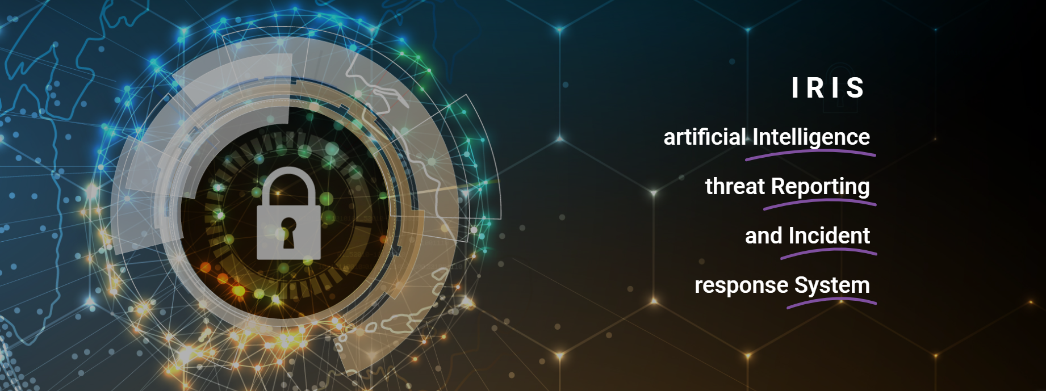

Slide 2

IRIS
A collaborative CERT/CSIRT platform to combat cyber-threats in IoT and AI-driven systems
Duarte Nascimento (INOV)
PUC 2 | 27/03/2024

Slide 3
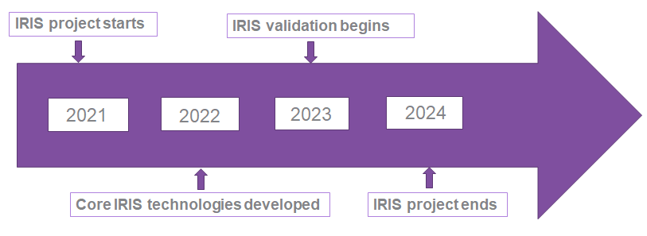
Project at a Glance
Call Identifier: 2020-SU-DS-2020
Topic: SU-DS02-2020 Intelligent security and privacy management
EC Funding: 4 918 790.00 EUR
Duration: 36 months (Sept 2021-Aug 2024)
Consortium: 19 partners
Coordinator: INOV - Instituto de Engenharia de Sistemas e Computadores, Inovacão, (INOV), Portugal
Learn More: www. iris-h2020.eu
Join us: @iris-h2020
IRIS H2020 Project
6 Public organizations
3 SMEs
4 Large ICT industries
6 Research institutions & Universities
Consortium

Slide 4
IRIS Motivation
As existing and emerging SMART CITIES continue to expand their IoT and AI-enabled systems, novel and complex threats are introduced.
Architecture and behaviour of emerging IoT and AI technologies are not currently well understood by security practitioners, such as CERTs and CSIRTs.

Slide 5

IRIS Vision
The H2020 IRIS project aims to deliver a framework that will support European CERT and CSIRT networks detecting, sharing, responding and recovering from cybersecurity threats and vulnerabilities of IoT and AI-driven systems.
Complement the existing MeliCERTes open platform and tools.
The IRIS Platform will be made available, to the European national CERT and CSIRTs, by the end of the project.

Slide 6
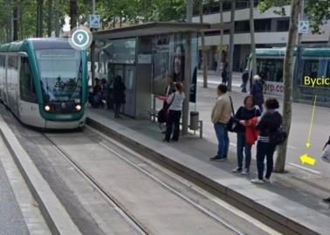
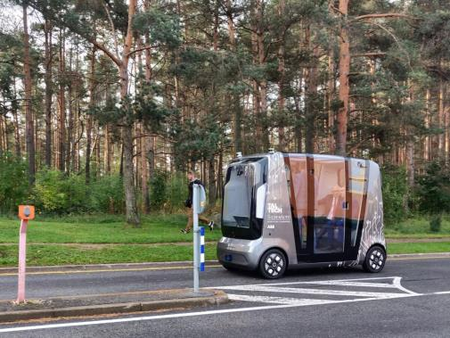
Key Takeaways
Smart Cities => novel, cutting edge AI/IoT-driven technology
This implies Emerging Threats ! High risks!
Currently, lack of experience as well as of tools for incident management that tackle IoT & AI attack vectors
IRIS will enhance the capabilities (knowledge, toolset, training) of CERTs/CSIRTs, to address these challenges.

Slide 7
What to expect from this Pilot
Knowledge of advanced tools to address IoT and AI threats, in Smart Cities.
YOUR FEEDBACK MATTERS !
  What are your drivers, needs, and pain points?
  Are there social acceptance benefits or issues?
Join the Stakeholder Community, and influence the IRIS roadmap.

Slide 8
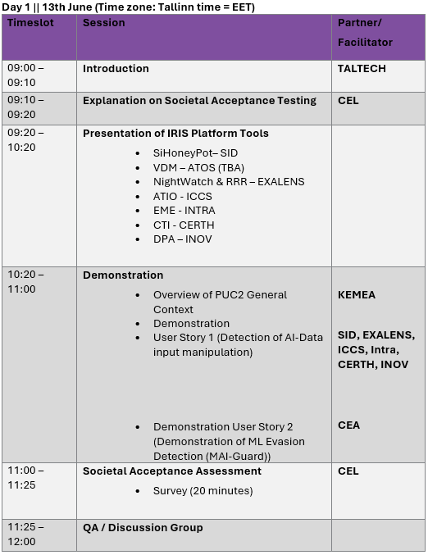
Agenda

Slide 9
IRIS PUC 2 – Introduction
PUC 2 | 13/06/2024 | TALTECH

Slide 10
IRIS – Pilot Use Case 2 Tallinn
Aim:
  Evaluate the capability of the IRIS Platform for cyber incident response in AI and IoT environments.
  Assess the enhanced ability, delivered by IRIS, of System Administrators and CERTs/CSIRTs to work collaboratively in cyber incident response.
  Enhance the security of AI-based systems
Benefits:
  Enhanced capability for cyber incident response including cooperation with CERTs/CSIRTs
  Improved security for AI based Systems
Notes:
CLS:CYBERLENS BV
SID: SIDROCO HOLDINGS LIMITED

Slide 11
IRIS – Pilot Use Case 2 Tallinn
Tallinn Pilot Use Case focuses on evaluating selected tools from the IRIS platform (Nightwatch (Probe and RRR), ATIO, SiHoneyPot (Indirectly), DPA, CTI(Indirectly)) to support cyber attack detection and incident response in an AI-based system and supporting infrastructure.
Within Tallinn, the AI-based system focusses on Autonomous Transportation, mainly systems and data of an autonomous vehicle shuttle and smart city planning.
The Tallinn Pilot Use Case that will be demonstrated today focusses on a cyber attack scenario where telemetry from the autonomous vehicle is manipulated to affect the integrity of decision-making of the Urban Operating Platform (UoP), a system used for transportation planning.
Notes:
CLS:CYBERLENS BV
SID: SIDROCO HOLDINGS LIMITED

Slide 12
IRIS – Pilot Use Case 2 Tallinn
The aim of the Pilot is to present to relevant stakeholders the IRIS platform, demonstrate its capability and effectiveness and engage with you in feedback.
Notes:
CLS:CYBERLENS BV
SID: SIDROCO HOLDINGS LIMITED

Slide 13



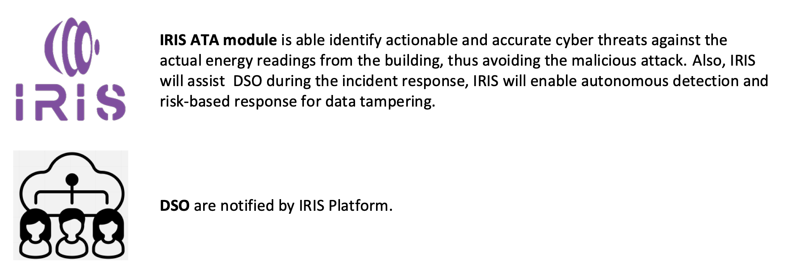
User story – Malformed Data Injection
Threat actor aims to sniff network traffic of communication between autonomous vehicle shuttle and the smart city management platform (UoP) to then manipulate the telemetry of the autonomous vehicle to cause the UoP to make incorrect city and transportation planning decisions.
Transportation System Administrator keeps track of the infrastructure operational environment.
SiHoneyPot is a honeypot which uses synthetic data of the LiDAR sensor to replicate its telemetry data footprint. The LiDAR data is streamed to the UoP.
Nightwatch probe extension will receive the autonomous vehicle telemetry data which is being fed to the UoP. The probe will parse the data to the Nightwatch Cortex to detect anomalies in the data. A report is then sent to the ATIO.
ATIO will enrich the threat information and manage the workflow for cyber incident response with the RRR and EME.
RRR will enable options for risk-based recovery and self-healing.
EME Dashboard will enable visualisation of the threat information.
DPA will ensure auditability and traceability of data and associated user interactions within the incident response workflow.
CERTs/CSIRTS will interact with the Transportation System Administrator to manage the cyber incident response.

Slide 14



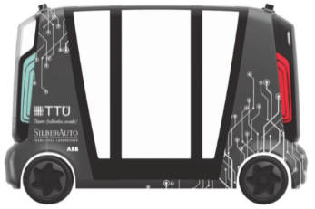

User story PUC 2
The goal of IRIS PUC 2 is to evaluate IRIS platform tools for cyber incident response and recovery for an autonomous transportation case study.
We will demonstrate:
  Detection of Attack that seeks to manipulate the telemetry data of an AV which is used as an input to a smart city planning system.
  Workflow of cyber incident response and recovery, demonstrating capabilities for threat information enrichment and sharing.
Manipulate
Attacker
Intercept
Urban Operating Platform – AI-Based Planning Tool
LiDAR Data
Manages Environment
SiHoneyPot – LiDAR Data
Transport System Administrator
CERT/CSIRT

Slide 15





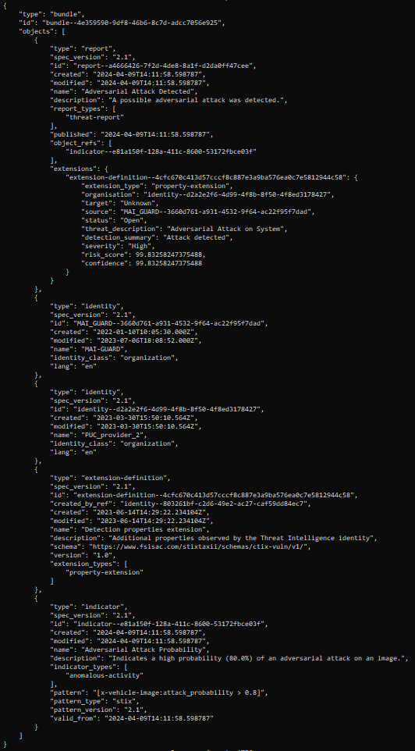


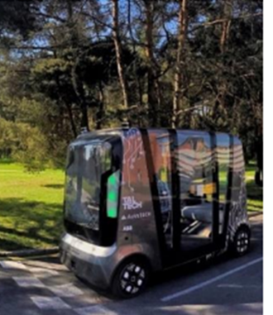



User story PUC 2
No object
MAI-GUARD
Attack Report
(2) “No object
ahead”
YOLO
model
Perturbation
(1)
(3)
+
(1)
ATIO
(4) Attack detected
Autonomous shuttle
Notes:
(1) As before the shuttle camera sends an image to the image analysis system, but this time an attacker interposes between the camera and the image analysis system and modifies the image
(2) The image analysis system being deceived does not detect any object and misinforms the navigation system
(3) MAI-GUARD detects an attack and sends an attack report to the ATIO
(4) ATIO processes the attack report and informs the shuttle navigation system

Slide 16
User story – ML Evasion Attack
Threat actor poisons the training data which is used to train the object detection algorithm used by the Autonomous Vehicle for perception and collision avoidance actions
Transportation System Administrator keeps track of the infrastructure operational environment.
MAI-GUARD will detect the attack and send a report to the ATIO
ATIO will enrich the threat information and manage the workflow for cyber incident response with the RRR and EME.
EME Dashboard will enable visualisation of the threat information.
CERTs/CSIRTS will interact with the Transportation System Administrator to manage the cyber incident response.

Slide 17
User Story: Why are these user stories important?
Integrity of AI-based systems: Threat actors may compromise the integrity and security of AI-based systems which affect the decision-making of the AI system and impact users of the system and citizens.
Data Breach: Sensitive data may be sniffed by an attacker which can use the data to craft further attacks and/or reverse engineer the AI model.
Device Manipulation: Attackers might tamper with the underlying infrastructure which supports the AI-based system.

Slide 18
User Story: Why are these user stories important?
Integrity and Authenticity of CTI Information: Threat sharing information and information on the workflow of cyber incident response systems require audit and traceability to assure the integrity and authenticity of information.
Innovative Technology: The use of innovative distributed ledger technology to enhance the integrity of the CTI workflow.

Slide 19
IRIS PUC 2 – General Context
PUC 2 | 13/06/2024 | KEMEA

Slide 20
IRIS Pilots - Key Objectives
The demonstration pilots of IRIS target to:
Secure the smart city’s IoT and control systems against confidentiality breaches, detecting interception and compromise of IoT systems and reporting efficiently the breach (PUC1 in Barcelona).
Securing a smart city's AI-enabled infrastructure of transport systems (autonomous buses), illustrating IRIS capabilities to identify the threat, self-recover and share the threat intelligence with other system operators and platforms (PUC2 in Tallin).
Protect the customer facing components of the smart grid against threats to control functions defined for the control of the demand, demonstrating IRIS capabilities to manage a cross-border crisis exercise on the Virtual Cyber Range (PUC3 in Helsinki/Tallin).
IRIS platform focuses on:
  Real-time estimation of cybersecurity and privacy risks
  Automated threat detection, response and recovery
  Threat intelligence sharing
  Measures for effective cybersecurity incidents and crises management
Notes:
CLS:CYBERLENS BV
SID: SIDROCO HOLDINGS LIMITED

Slide 21
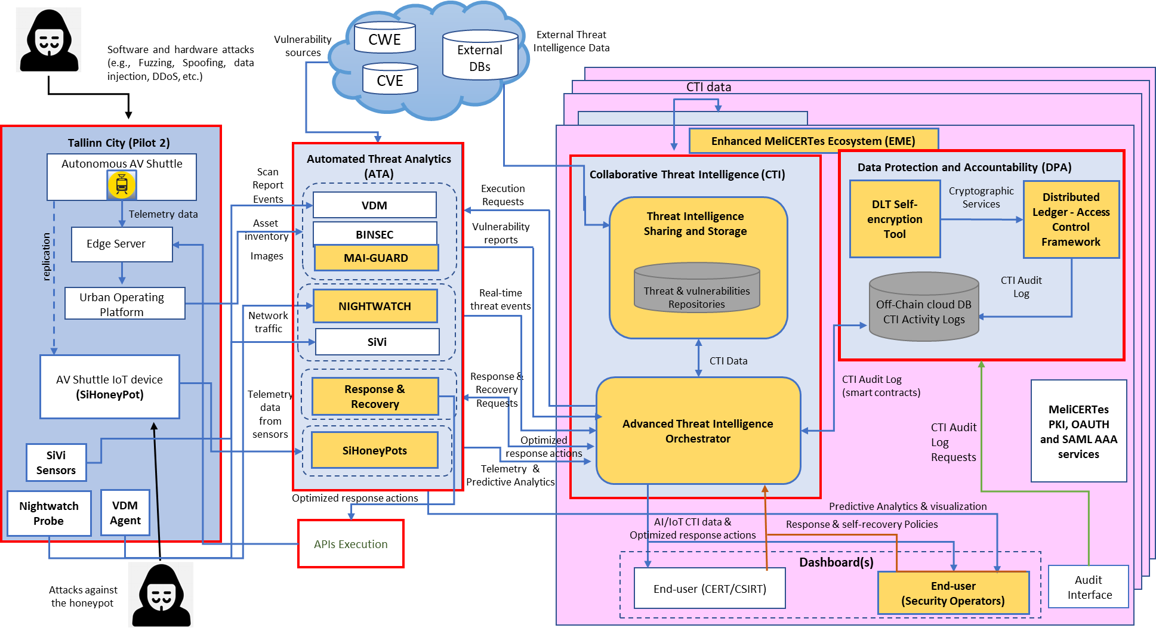
IRIS General Architecture

Slide 22
IRIS PUC 2 – SAT
PUC 2 | 27/03/2024 | CEL

Slide 23

Social Acceptance Assessment
This session is also part of our research on the social acceptance of IRIS project
The aim is to get a feedback on the presentation based on your perceptions
Following the pilot use case presentation we will invite you to fill in a survey

Slide 24

Social Acceptance of Technology
IRIS model
BASED ON 3 PRINCIPLES
Human centredness,
Leave no one behind
Ethics-by-design
WHO: CERTs/Csirts, Transport sector stakeholders to assess the IRIS technological solution
WHAT: perceptions on the IRIS Platform.
HOW: demos, survey, focus groups to assess different dimensions of social acceptance
Notes:
We focus on social acceptance because it has become clear that the acceptance of innovation is not only due to technical features of a product or of a solution but also to other variables such as behavior, opinions, awareness, attitudes and beliefs.
At cybersecurity Lab we elaborated a model to assess Social Acceptance at different stages of the research and design process.
CyberEthics Lab. developed a methodology to assess social acceptance of technology SAT (Occhipinti et al. 2022) which takes social acceptance as a function of user experience, combined with perceived disruptiveness of the technical solution, its impact on values and trustworthiness.
Out model is based on three principles: We take the social acceptance of a solution as a function of four components, called bubbles.
SAT can be applied not only with end-users but also with other stake holders
SO today you are the experts we would like to assess the iris technology, and we are interested in your expectations perception… we will conduct this focus groups and then ask you to fill in a survey.

Slide 25
IRIS Tools Presentation
PUC 2 | 27/03/2024 | CLS, SID, ICCS, INTRA, INOV

Slide 26
SiHoneyPot
Description: SiHoneyPot is a novel high-interaction honeypot that leverages the latest trends in microservices and Digital Twin technology to emulate the behavior of real-world sensors and embedded devices in industrial, IoT, and AI applications.
Key Components:
  The LiDAR Honeypot that emulates LiDAR sensors found in Autonomous Vehicles (AVs).
  The Modbus Honeypot that harnesses deep generative neural networks to emulate the behavior of industrial devices that communicate through the Modbus protocol.
Key Features:
  Dedicated Dashboards for visualizing the predictive and monitoring findings of the honeypots.
  An External Data Sharing module responsible for generating threat intelligence reports complying with STIX 2.1 standard and sharing them with the IRIS orchestrator and the EME ecosystem.

Slide 27
LiDAR Honeypot
Goal: The LiDAR Honeypot is designed to emulate a real-life LiDAR sensor, similar to the ones utilized in Autonomous Vehicles (AVs). The LiDAR honeypot creates a virtual representation of a real LiDAR by replicating its main functionalities.
Key features developed in IRIS:
    Streaming LiDAR data emulating a real-life LiDAR sensor
    LiDAR data from multiple different environments (urban, suburban, rural, etc.)
    Identifying data manipulation attacks
    Collecting telemetry data regarding the attacker’s behavior
    Analyzing and visualizing attacker’s telemetry data on SiHoneyPot dashboard
    Sharing triggered alerts with external third-party tools
    Administrator's ability to review and download raw log files

Slide 28

Nightwatch:
IRIS’s Cyber-Physical AI Anomaly Detection Tool
28
Notes:
28

Slide 29

The Nightwatch Tool
Nightwatch is a by-product of the Exalens® Cyber-Physical AI platform that seamlessly unifies device, network, and physical process monitoring to automate root cause analysis, spot, and respond to cyber threats, system faults, and equipment failures in seconds.
Platform Features:
  Network IQ
  Threat Detection & Asset intelligence
  Process IQ
  AI-powered Process Anomaly Detection & Monitoring
  Source IQ
  AI Analyst automating Root-Cause Analysis
Deployment methods:
  On-Premise / Cloud / Hybrid
29
Notes:
29

Slide 30
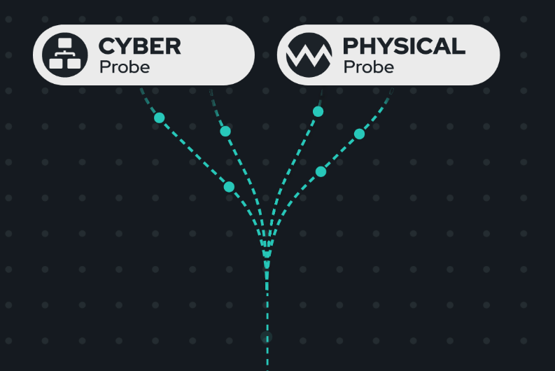
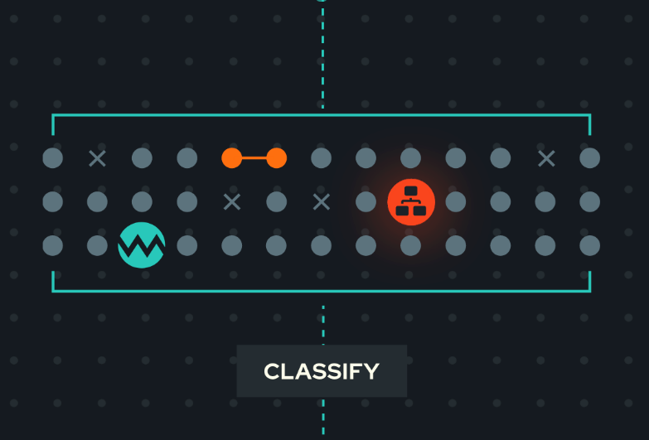
Key Innovations
Complete Visibility
Continuously track and profile device, application and network activity across IT, IoT, and OT systems.
Securely upcycle physical machine and process data via native integration with existing operational systems – no infrastructure changes required.
Seamlessly, and securely, combine both cyber and physical process analysis within a single, agentless monitoring platform.
Smart Detection
Detect threats, vulnerabilities and anomalies in both device and physical process activity and track them as they evolve over time.
Autonomously analyse, assess and link related cyber and physical incidents across IT, IoT and OT systems in seconds.
Achieve low false positives and negatives with intelligent risk and threat classification, mapped to MITRE ATT&CK ICS.

Slide 31
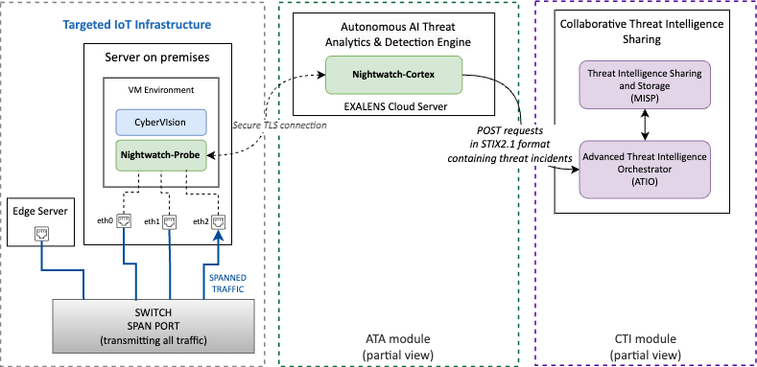

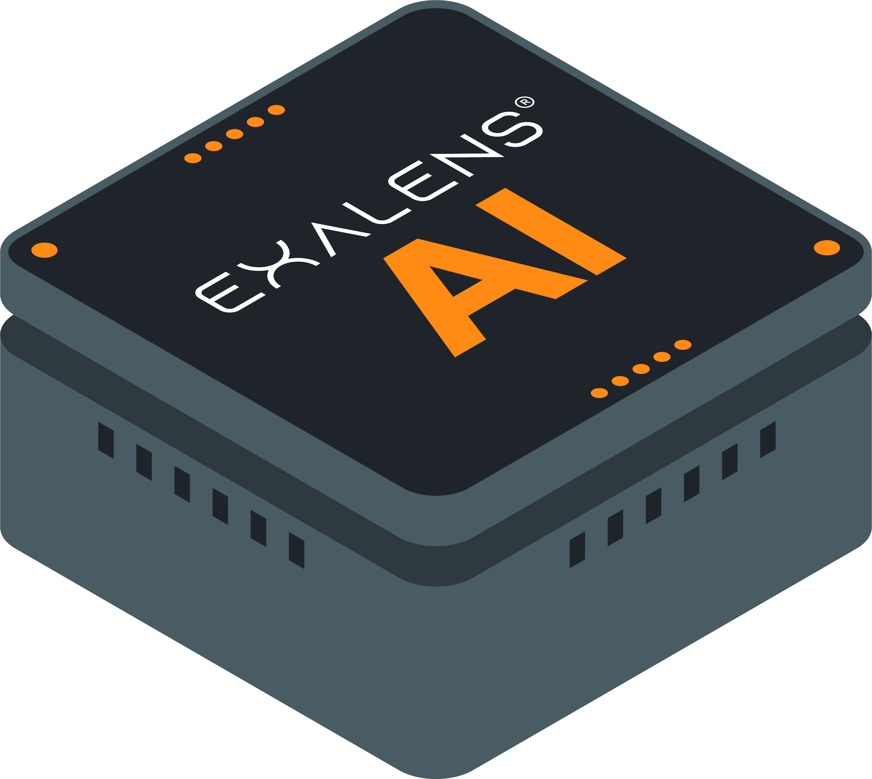


Nightwatch Architecture
Main components:
The Probe monitors the traffic, generates logs relative to the monitored endpoints, and collects data, and information relative to various network protocols.
The Cortex analyses and inspects the collected logs by seamlessly passing them to a detection mechanism composed by Nodes (collaborative fleet of detectors). Upon detecting an anomaly, the Cortex publishes incident alerts in JSON format to become visible to the IRIS end-users.
Data Processing
Data Sharing
Data Collection
Data Source
High-Level, Component-based Architecture of the Nightwatch tool

Slide 32
Network (Cyber) Threat Detections
# | Detection Node | Protocol
1 | C2 Beacon Suspicious beaconing to {external/internal} host(s) | HTTP
 |  | TCP, UDP
 |  | SSL
2 | Network Scanning Unusual internal network scanning activity | TCP, UDP
 |  | ARP, ICMP
3 | Brute Force Suspicious number of failed login attempts in small time interval | SSH
 |  | FTP, HTTP
 |  | RDP
 |  | SMBv2
 |  | KRB
 |  | LDAP
 |  | NTLM
 |  | TELNET, VNC
4 | Network Flood Unusual number of consecutive connections with small interval | TCP
 |  | UDP
 |  | ICMP
5 | ARP Poison Suspicious unsolicited ARP messages ARP Unanswered Unanswered ARP requests | Suspicious ARP replies
 |  | Unanswered ARP requests
# | Detection Node | Protocol
6 | Discovery Suspicious discovery / enumeration activity | Network discovery
 |  | System accounts discovery
7 | Execution Remote service/ task creation Suspicious remote Service / Task creation | wmi_service
 |  | scheduled_task
8 | Impact Suspicious remote Shutdown / Reboot | System shutdown/reboot
9 | Defence Evasion Suspicious attempt to remotely clear Windows event logs | Remote windows event log removal
10 | Lateral Movement Suspicious file transfer over | OS Credential Dumping
 |  | Failed SMB connections
11 | Reconnaissance Path Enumeration detection | HTTP
 |  | HTTPS
12 | Credential Access LLMNR/NBNS session hijacking detection | NTLM
 |  | SMBv2
 |  | DNS

Slide 33
Cyber-Physical Threat Detections
Nightwatch can detect malformed data injection attacks, a type of cyber-physical attack. It leverages a series of detection algorithms structured around the notion of indicator-based evaluation, to maintain the fidelity of data streams.
  Within IRIS, LiDAR data telemetry is scrutinized through a mapped model configuration which is in charge of selecting the appropriate indicators, models, and threshold values to detect abnormalities.
  The indicators cover a spectrum of potential anomalies:
  Value Deviation
  Rate of change
  State & Transition Behaviour
  Update Timing Intervals
  Correlated Value Deviation
  Correlated Rate of Change
  Correlated Update Timing Intervals
  Correlated State & Transition Behaviour
  Correlated Transition Frequency
  Unexpected Process Configurations

Slide 34
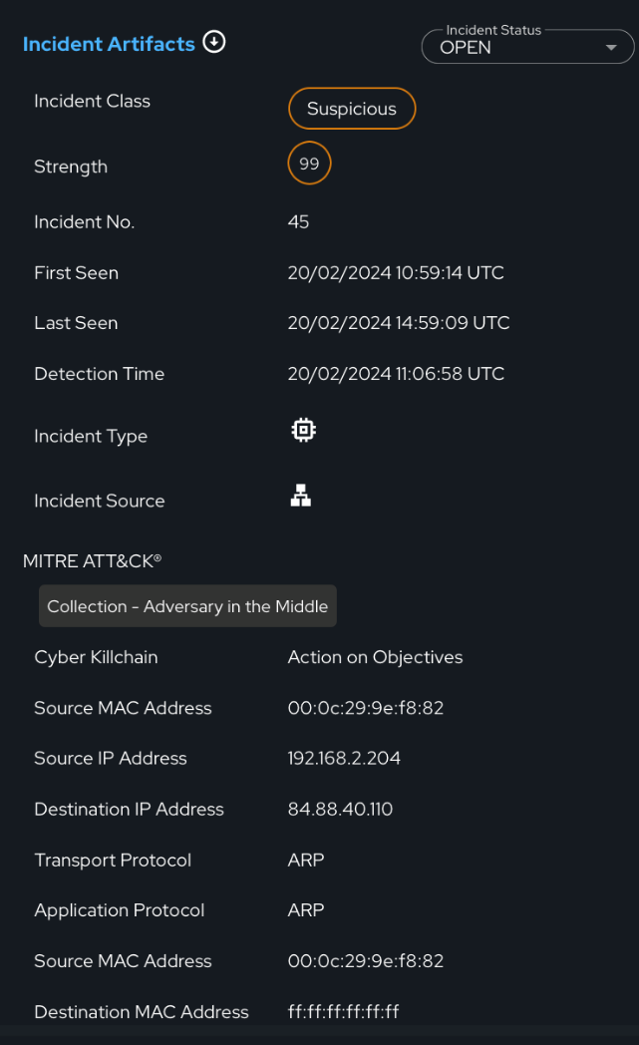
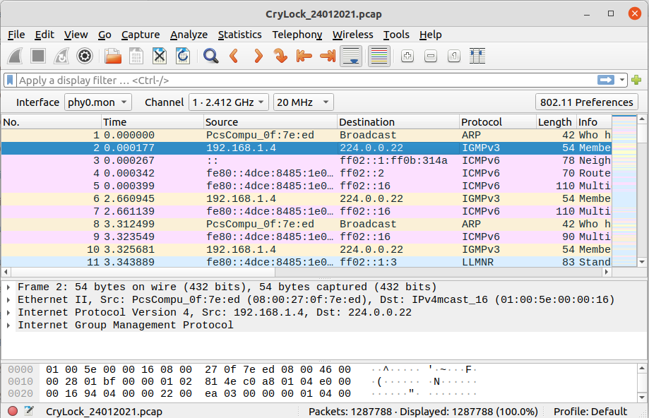
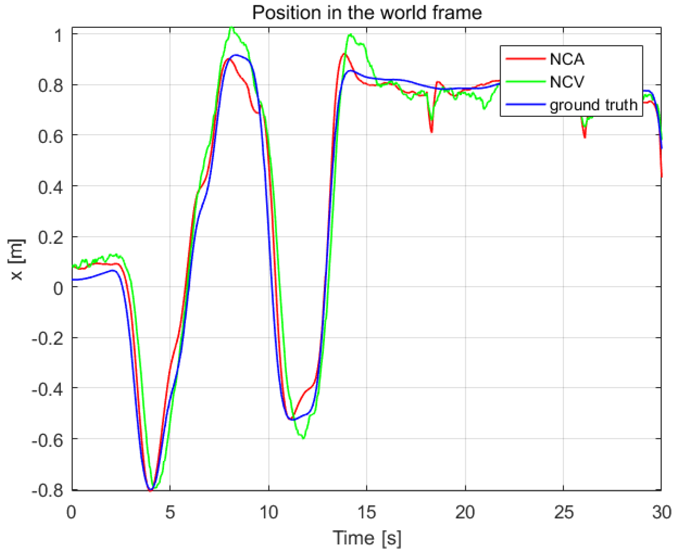




Input & Output Data
Network (cyber) data
  .pcap files
  physical interfaces (eth1, ...)
    Network
    SPAN/TAP
    Protocols accepted: TCP, UDP, ICMP, ARP, DNS, HTTP, SSL, etc.
Physical data
  log files & streaming flows
    .csv, .log, Redis, Kafka ingestion
  M2M Protocols
Output data
Input Data

Slide 35
RRR:
IRIS’s Risk-based Response & Self-Recovery Module
35
Notes:
35

Slide 36
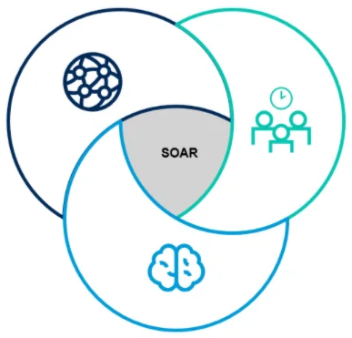
The RRR Module
The Risk-based Response & self-Recovery (RRR) module of the IRIS platform is a risk-based decision-support framework underlying the IRIS Automated Threat Analytics (ATA) incident response and self-recovery procedures.
RRR leverages an array of optimization, and machine learning algorithms to evaluate the incident data and dynamically formulate the optimal Course of Action (CoA) concerning a detected incident.
RRR builds upon innovations in Security Orchestration, Automation, and Response
(SOAR) as well as in threat intelligence execution.
  It includes a self-recovery mechanism that adapts a programmable API to
  implement remediation actions without the need for human intervention.
Despite its automation prowess, in IRIS, human oversight is paramount.
Accordingly, RRR’s decision-support framework is supervised by policies
defined by CERT/CSIRT operators.
  These automation policies are enacted through the IRIS EME dashboard.
Security Incident Response Platforms
Security Orchestration & Automation
Threat Intelligence Platforms
36
Notes:
36

Slide 37
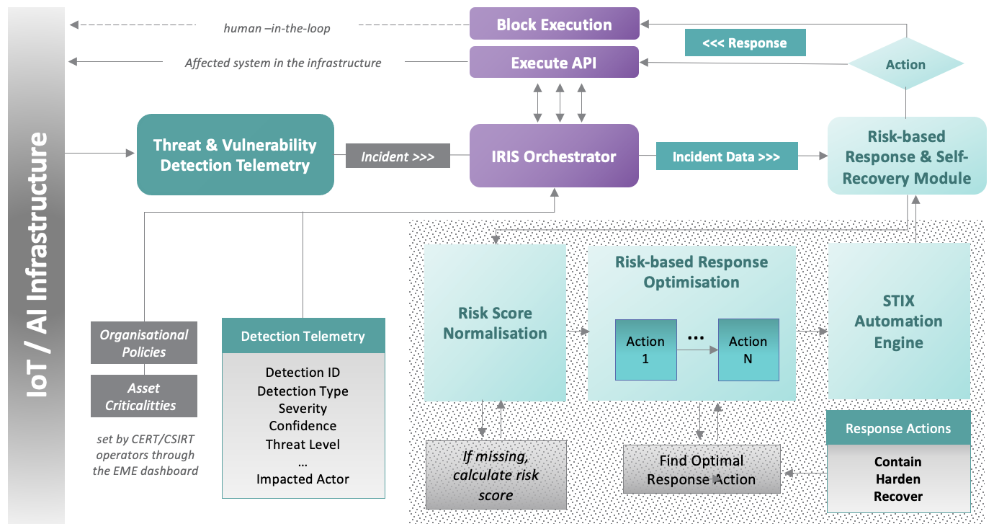
RRR Architecture
Main Components:
  Risk score normalization engine: it normalizes the incident data transforming values into anticipated data types and scales to facilitate risk-based response.
  Optimization engine: it selects optimal response action(s) to a detected incident by employing optimization and ML algorithms.
  STIX automation engine: it shares the selected incident response workflow in the form of STIX-CACAO playbooks enabling the seamless exchange of threat intelligence with security platforms, like MISP.
RRR’s Reference Architecture
37

Slide 38
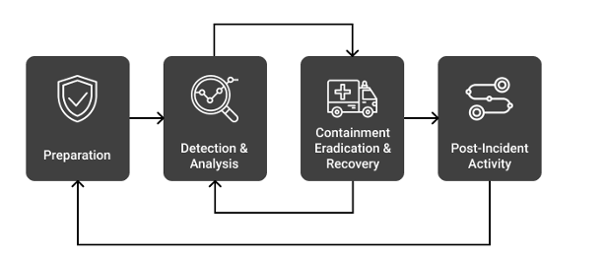
Incident Response Methodology
Compliance with NIST
RRR’s incident response methodology is in line with the NIST framework for incident handling described in the Computer Security Incident Handling Guide (NIST SP 800-61).
Post Incident Activity
Containment, Eradication & Recovery
Detection & Analysis
Preparation
The NIST Incident Response LifeCycle
RRR’s Incident Response Methodology
38

Slide 39
Input & Output Data
Compliance with STIX-CACAO
Output data
"playbook_actions": {
"type": "playbook",
"playbook_id": "",
"spec_version": "cacao-2.0",
"playbook_standard": "CACAO",
"name": "playbook name",
"playbook_valid_from": ”…",
"playbook_valid_until": ”…..",
"organization_type": "Org1",
"asset": "192.168.2.200",
"risk_score": "59.0",
"playbook_impact": "79.0",
"playbook_severity": "79.0",
"playbook_priority": "79.0",
"playbook_type": "detection",
"workflow_start": "3",
"workflow": [
{
"id": 2,
"impacted_actor": "10.0.1.1",
"action": "Isolate Host",
"description": "It is recommended that …",
"execution_api": ”isolate_host()",
"action_impact": 10
},
]
}
CACAO playbook
"detection": {
"organisation": "Org1",
"detection_name": "Suspicious Unknown beaconing to External host",
"detection_summary": "192.168.2.50 was observed making suspicious beaconing ….",
"source": "Nightwatch",
"classification": "THREAT_BEHAVIOUR",
"first_seen": "1678150861.979507",
"last_seen": "1678151643.938273",
"actor": "192.168.2.50",
"confidence": "0.999999999",
"risk_score": "79",
"severity":"4.3",
"threat": ”high",
"iris_id": 782
},
Detection Telemetry
Input Data
“policies": {
"organisation": "Org1",
"action_policy": {
"contain": {
"isolate": "enabled",
"block_service": "enabled",
"shutdown": "enabled"
},
"harden": {
"install_patches": "enabled",
"disable_service": "enabled",
"implement_access_control": "enabled"
},
"recover": {
"restore": "enabled",
"reconfigure": "enabled"
}
}
}
Policies
"criticalities": {
"organisation": "Org1",
"asset_ip": "192.168.2.50",
"asset_device": "Kali",
"criticality": "2"
}
Asset Criticalities
39

Slide 40
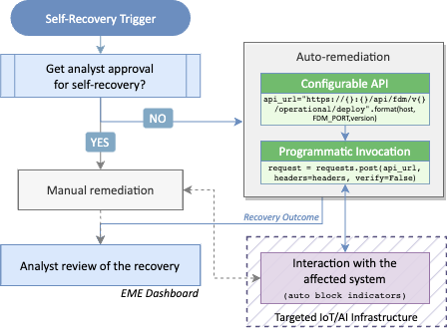
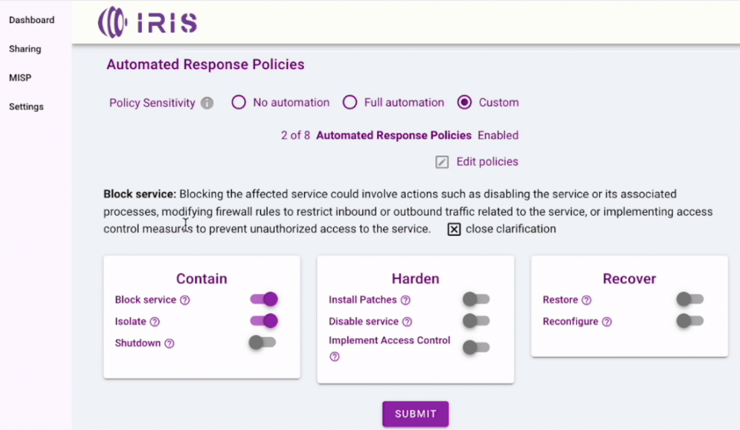
Self-Recovery Mechanism
Key aspects:
  RRR integrates a programmable API connecting seamlessly with external APIs to effect remediation actions without the need for human intervention.
  Organisation-specific automation policies determine whether the response and recovery workflow will automatically be enacted or will require review / approval from the critical infrastructure operator.
IRIS-Enhanced MeliCERTes Ecosystem
RRR’s self-recovery process
40

Slide 41
Advanced Threat Intelligence Orchestrator
ICCS
PUC3| 13/06/2024

Slide 42


Adhering to Security Orchestration Automation and Response (SOAR) capabilities
Streamline operations
ATIO
Tools
Sharing
Full stack Middleware
Input
Output
User
Response

Slide 43
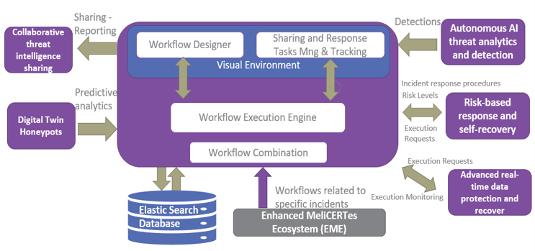
Advanced Threat Intelligence Orchestrator (ATIO) introduction
Advanced Threat Intelligence Orchestrator (ATIO) - Full stack Service Middleware

Slide 44
Advanced Threat Intelligence Orchestrator (ATIO) Structure
Back end and Front end Services
Orchestration Workflow Manager (OWM)
Sharing and Response Task Management and Tracking
Workflow Execution Engine
Workflow Combination
Data Exchange Framework
Command Execution Requests Framework
ATIO database

Slide 45
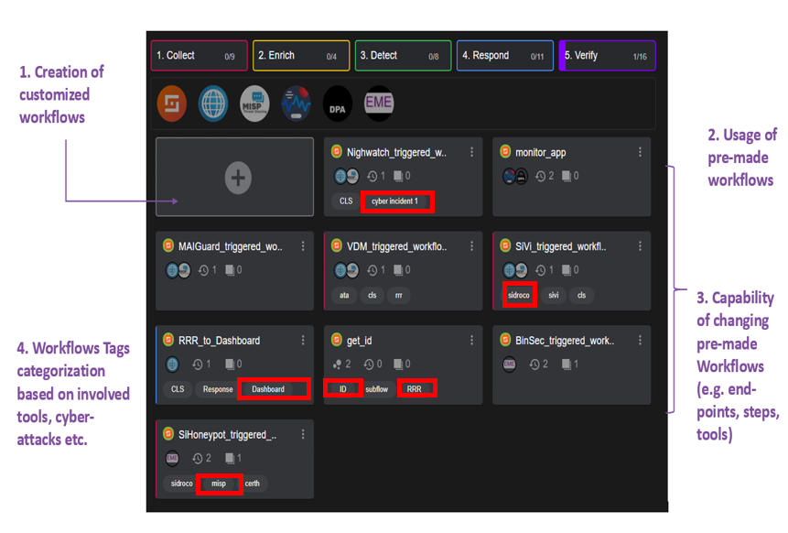
Orchestrator (ATIO) Workflow Designer (OWM)

Slide 46
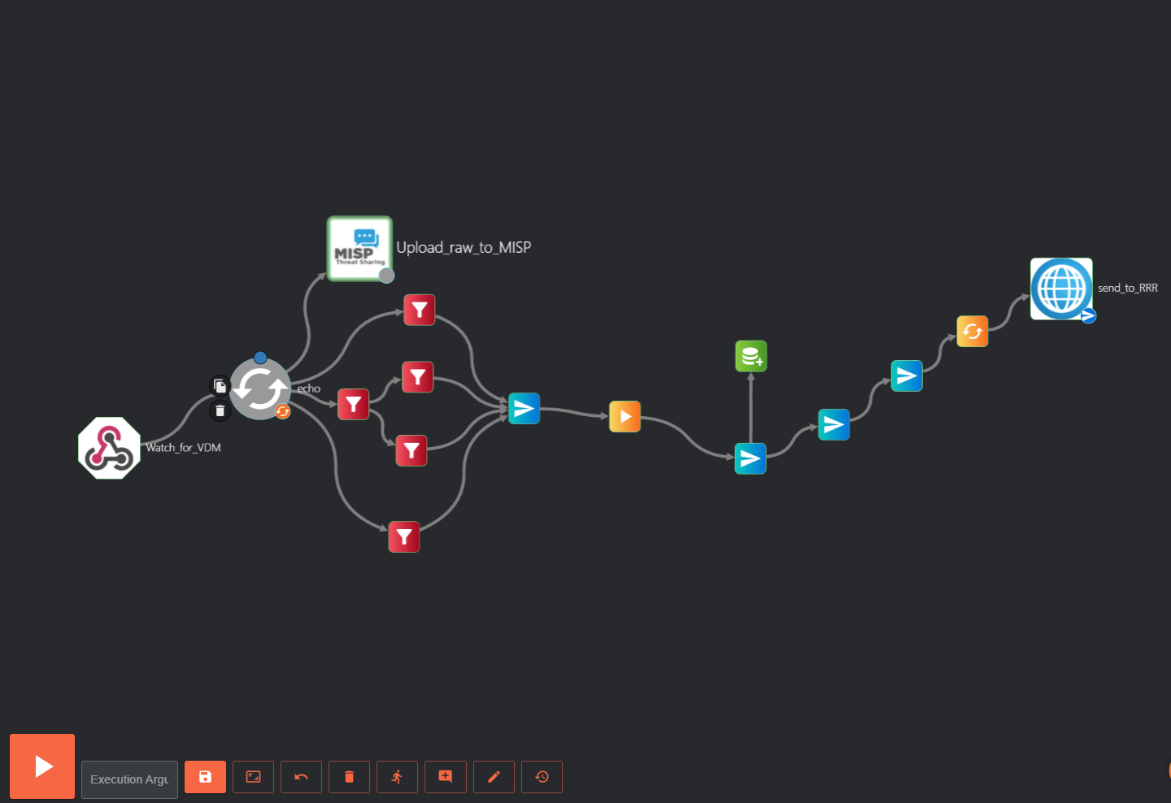
Terminology of Workflow execution through Shuffle environment
Automatic end-to end workflow execution and interpretation
Manual initiation of a workflow
Workflow steps
Arrows
Processing action steps
Subflows

Slide 47

Collaborative Threat Intelligence Sharing and Storage
Eleni Darra | CERTH

Slide 48
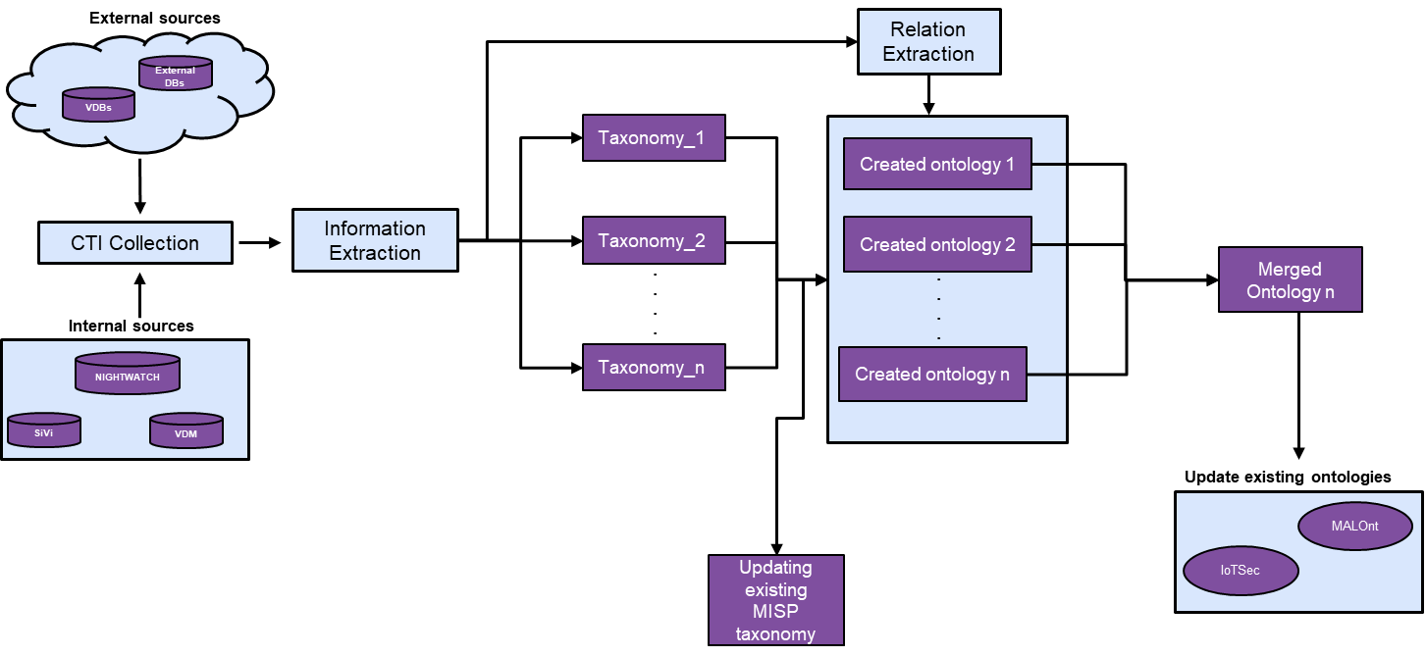
The role of CTI in the IRIS platform
CTI Collection
Information Extraction
Taxonomy generation
Update existing MISP taxonomy
Development of ontology
Merge with existing ontologies
Update existing ontologies
  Relation extraction: REBEL model
  Ontology development: OWLready2
  Ontologies merging: Semantic search
  Updated existing ontologies
    Update Malont based on class similarity
    Update IoTsec based on individual similarity

Slide 49
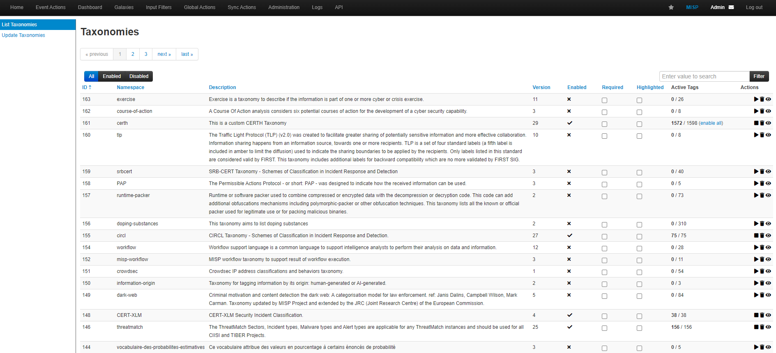
List of taxonomies in MISP

Slide 50
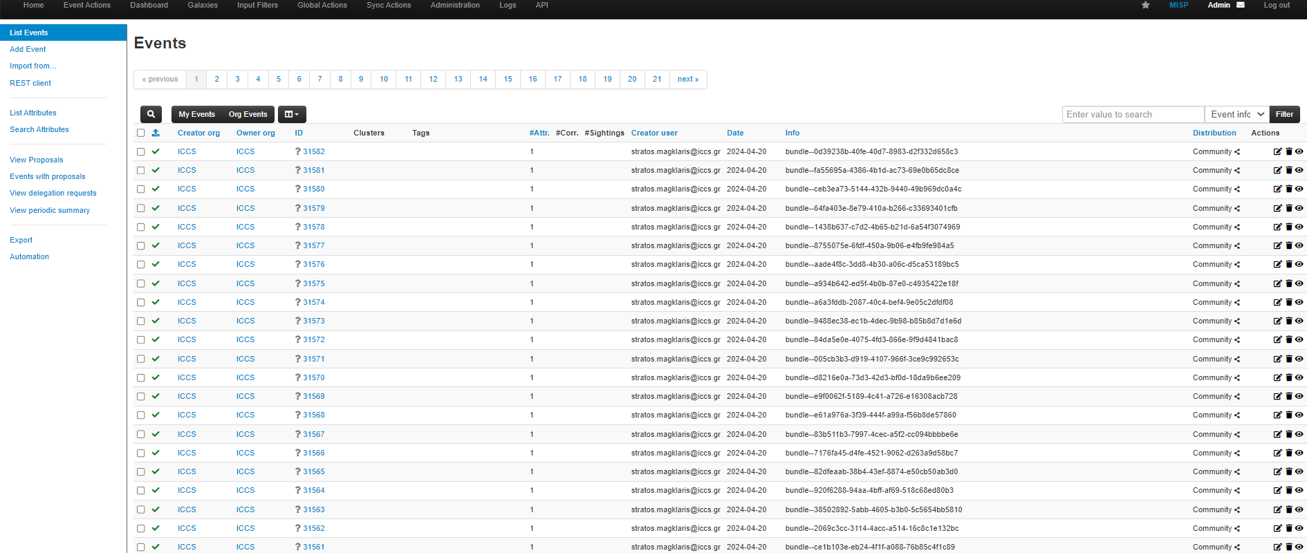
MISP events

Slide 51
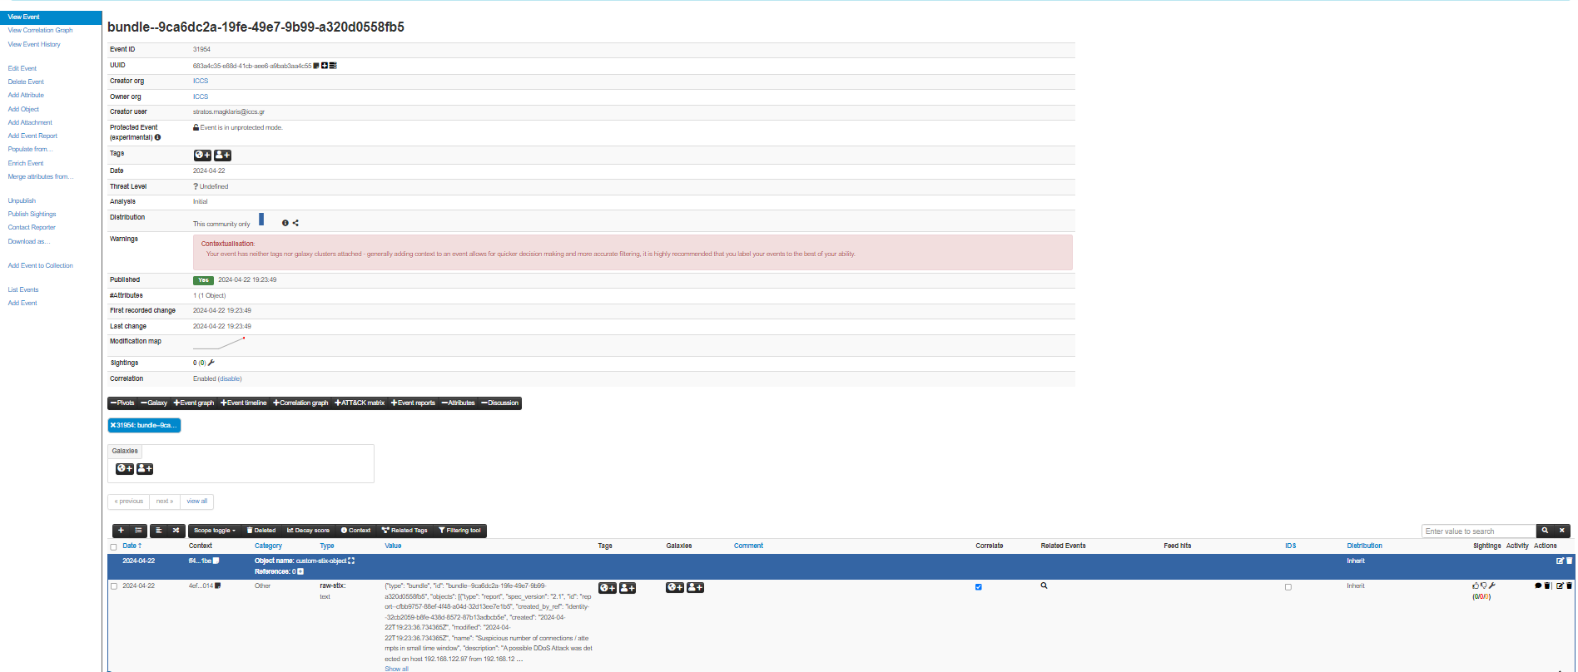

Slide 52
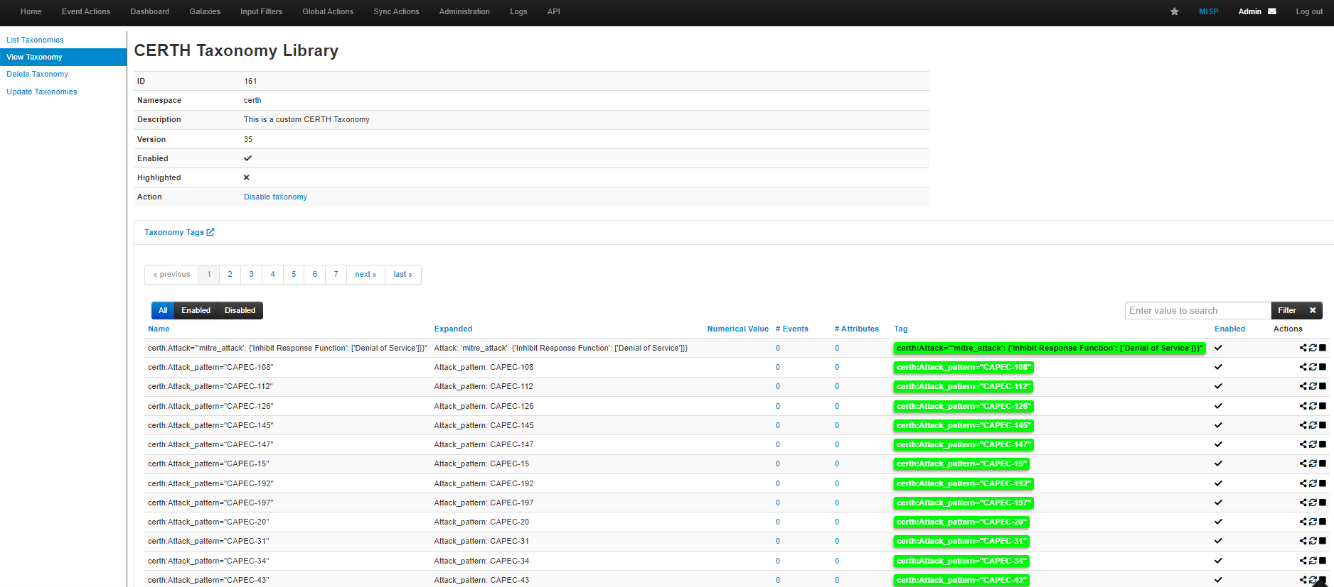
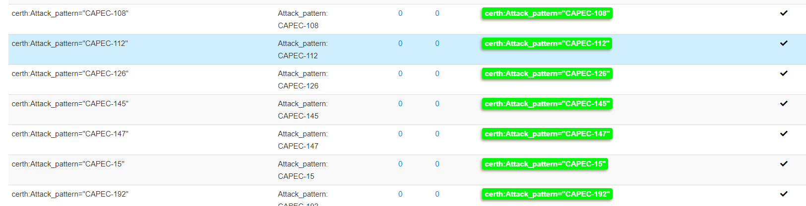
Taxonomy generation

Slide 53
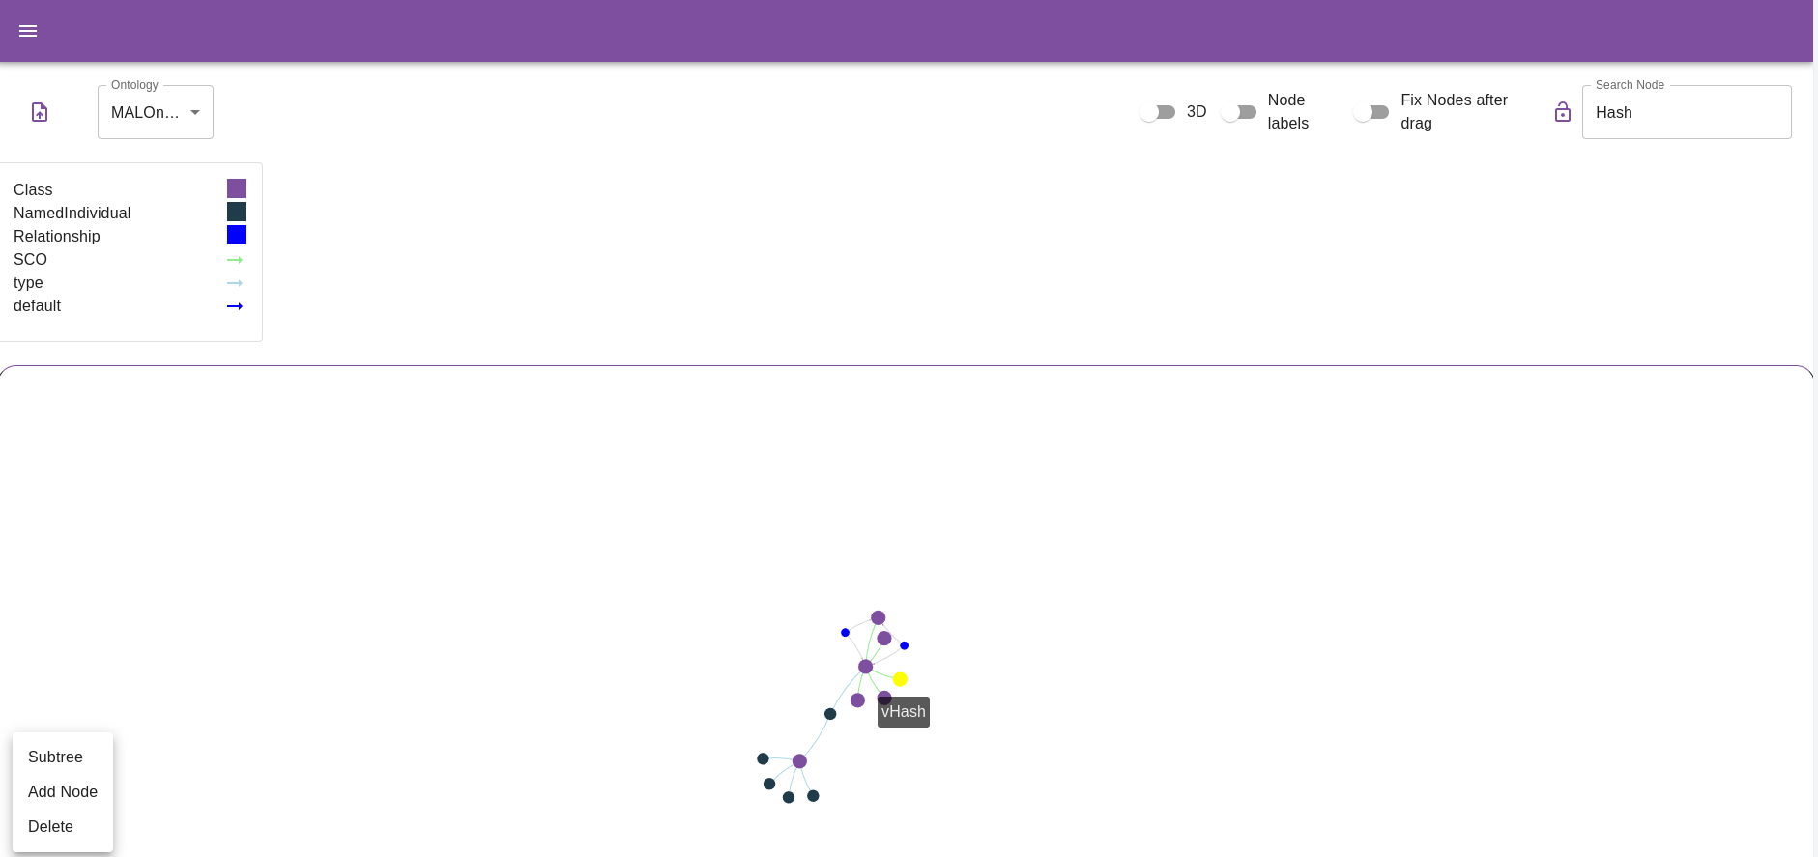
Ontologies visual environment

Slide 54
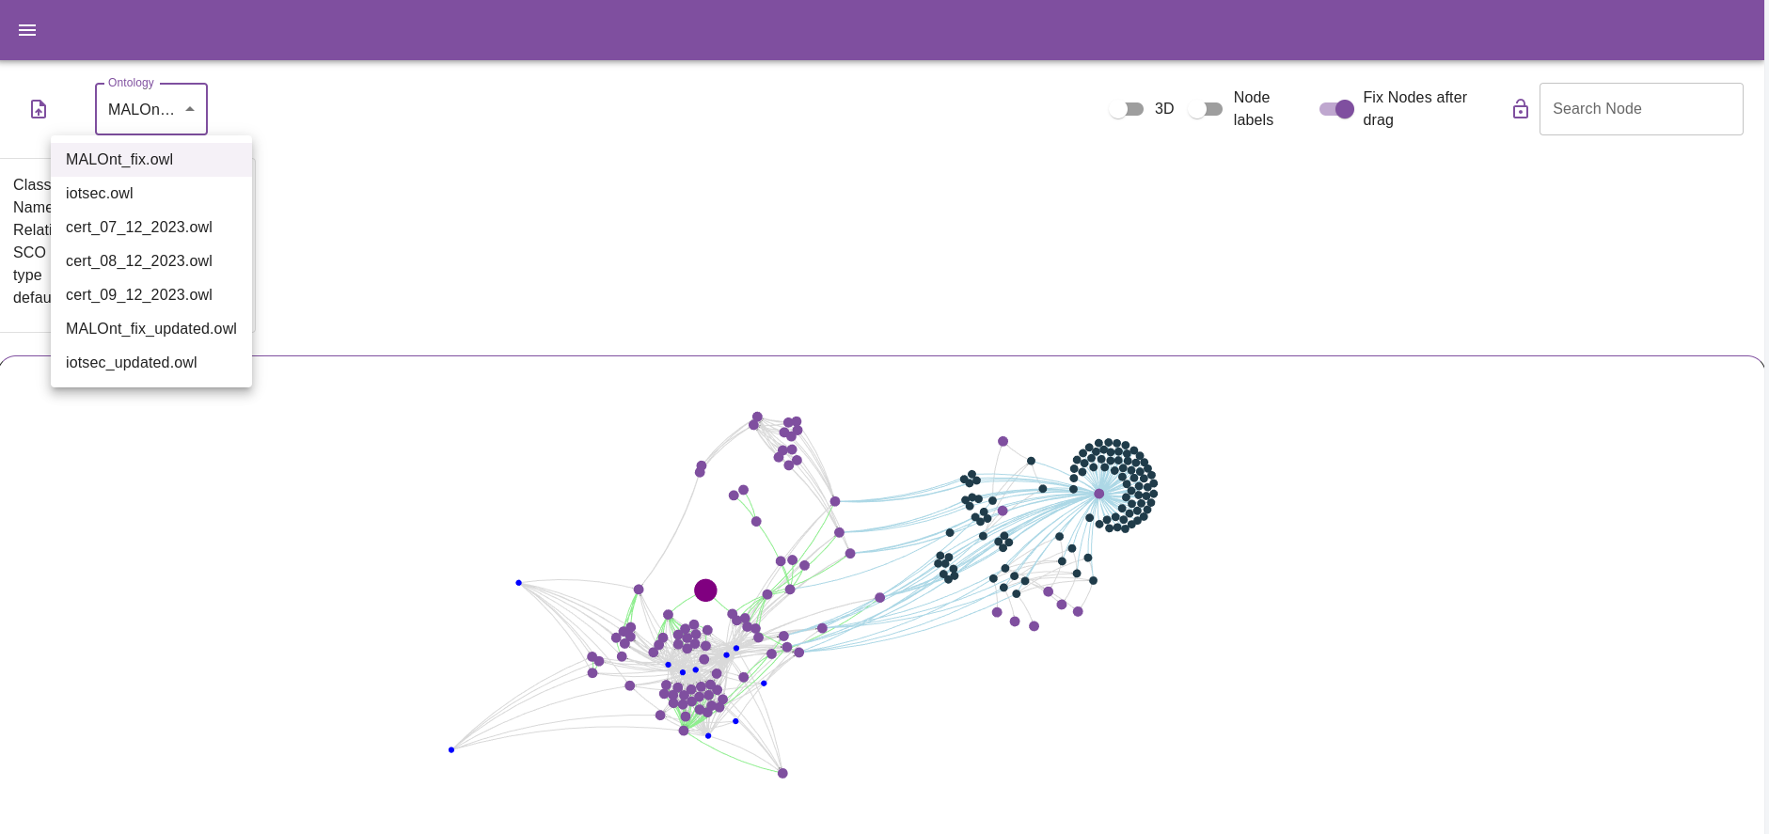
Ontologies visual environment

Slide 55
Data Protection and Accountability Module (DPA) – PUC 2
Duarte M. Nascimento, INOV
PUC 2 | June, 2024

Slide 56
DPA
Overview
The Data Protection and Accountability (DPA) module:
  Supports secure, immutable and traceable logging and auditing functions for incident response, enforcing accountability and promoting a network of trust in large-scale collaborative network environments (e.g., consortiums).

Slide 57

DPA
Scenario
Consortium
DPA
Organization A
Logging
REST
API
Hyperledger
Fabric
Entity A
System A
Organization B
Entity B
System B
Organization C
Entity C
System C

Slide 58
DPA
Component: Hyperledger Fabric Blockchain
Permissioned blockchain
Distributed ledger that preserves the traceability and immutability of auditing data
Architecture that implements the consortium and organization dynamic as services
  A consortium is implemented as an Hyperledger Fabric channel

Slide 59

DPA
Scenario
Consortium
DPA
Organization A
Logging
REST
API
Hyperledger
Fabric
Entity A
System A
Organization B
Crypto
Tools
Entity B
System B
Organization C
Entity C
System C

Slide 60
DPA
Component: Crypto-Tools
Provides the cryptographic functions needed for the DPA:
  Encryption mechanisms based on a novel Self-Encryption algorithm
  Secret Key Sharing mechanism based on the Shamir Secret Sharing protocol

Slide 61

DPA
Scenario
Consortium
DPA
Organization A
Logging
REST
API
Hyperledger
Fabric
Entity A
System A
Organization B
Crypto
Tools
Entity B
System B
Organization C
Off-chain
Database
Entity C
System C

Slide 62
DPA
Component: Off-chain Database
Encrypted auditing data is stored in an off-chain database, not in the blockchain
  Avoid blockchain bottlenecks – in the blockchain, only searchable metadata is stored
  The database is kept oblivious to the location of the blockchain, and vice-versa

Slide 63
DPA
Scenario
Consortium
DPA
Organization A
Logging
REST
API
Hyperledger
Fabric
Auditing
REST
API
Auditor
Entity A
System A
Organization B
Crypto
Tools
Entity B
System B
Organization C
Off-chain
Database
Entity C
System C

Slide 64



DPA
Stakeholders
The main stakeholders of the DPA:
  Organizations
    In the collaborative network
  Entities
    E.g., users belonging to the organizations and manually interacting with their systems
    Whose critical interactions are logged
  Auditors
    Internal or external conductors during auditing procedures
Consortium
DPA
Organization A
Logging REST API
Hyperledger
Fabric
Auditing REST API
Auditor
Entity A
System A
Organization B
Crypto
Tools
Entity B
System B
Organization C
Off-chain
Database
Entity C
System C

Slide 65
DPA
Usefulness to CERTs/CSIRTs
The DPA module can be used to:
  Record critical decisions, for future accountability purposes (e.g., auditing)
  Record critical changes (e.g., changing an automatic response workflow)

Slide 66
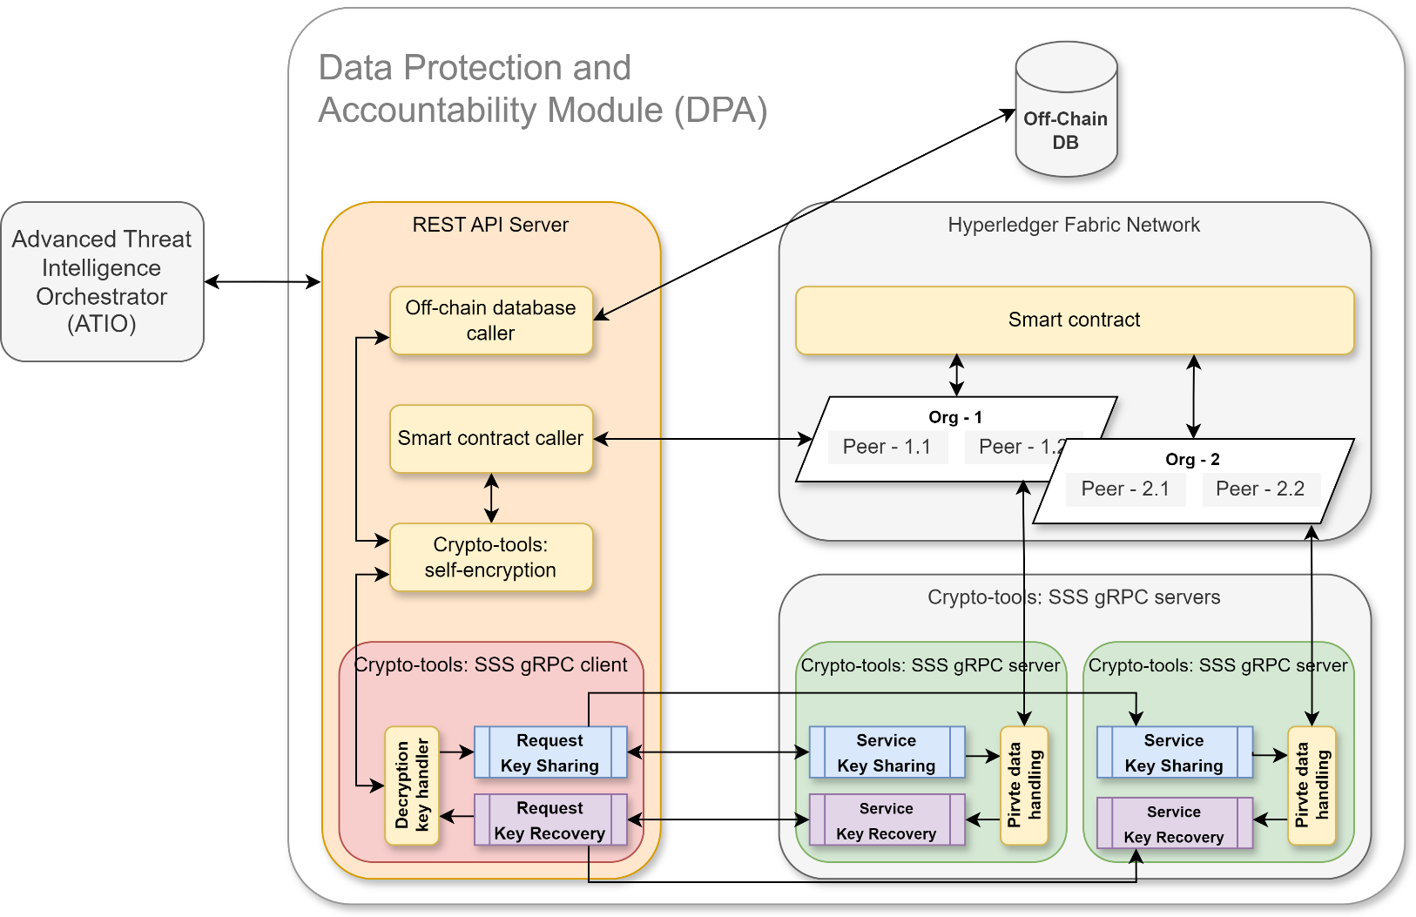
DPA
In the context of IRIS
In the context of IRIS, the DPA:
  Results from T4.4 and T4.5
  Is used by ATIO (T4.3) to log critical interactions
  Is present in PUC 2

Slide 67
IRIS PUC2 Demonstration
PUC 2 | 13/06/2024 |

Slide 68
IRIS User Story 1 - Demonstration
PUC 2 | 13/06/2024 | SID, CLS, ICCS, CERTH, INOV

Slide 69
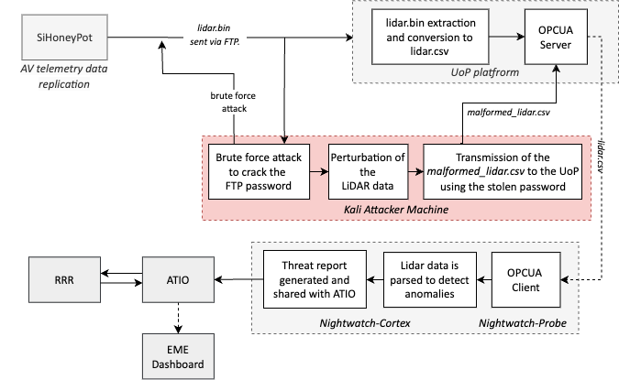
Attack detection workflow
Trigger: malformed data injection attack
192.168.122.89
1
4
1
LiDAR data sent to the UoP
2
2
Deployment of the BF attack
3
3
Malformed data injected to the UoP
login: user
pass: K3mbww2q:k7J08f0"8g#o238)3/DeL#D
4
LiDAR data sent to
Nightwatch for analysis
5
Nightwatch reports the anomaly
detected to ATIO
6
5
6
RRR calculates optimal
response recommendations
7
7
EME illustrates collected
threat intelligence to its UI

Slide 70
IRIS User Story 2 - Demonstration
PUC 2 | 13/06/2024 | CEA

Slide 71
MAI-Guard
Introduction
MAI-Guard is a comprehensive cybersecurity application designed by the CEA.
The aim, in the context of the project, is to generate, detect and report adversarial examples attacks on the artificial vision system of the autonomous AV shuttle (PUC2 – Tallinn)
Target : Adversarial attacks on images containing other vehicles and/or traffic lights to deceive the autonomous shuttle

Slide 72


MAI-Guard
First scenario : no attack
car
(3)
MAI-GUARD
(2) “Car
ahead”
YOLO
model
(4) No attack detected
(1)
ATIO
Autonomous shuttle
Notes:
(1) The shuttle camera system captures an image and sends it to the image analysis system (Yolo model)
(2) The image analysis system detects an object and inform the navigation system of the shuttle
(3) The image analysis system sends the image to MAI-GUARD for cyber-analysis
(4) MAI-GUARD does not detect any attack and informs the navigation system of the shuttle

Slide 73
MAI-Guard
Second scenario : attack
No object
MAI-GUARD
Attack Report
(2) “No object
ahead”
YOLO
model
Perturbation
(1)
(3)
+
(1)
ATIO
(4) Attack detected
Autonomous shuttle
Notes:
(1) As before the shuttle camera sends an image to the image analysis system, but this time an attacker interposes between the camera and the image analysis system and modifies the image
(2) The image analysis system being deceived does not detect any object and misinforms the navigation system
(3) MAI-GUARD detects an attack and sends an attack report to the ATIO
(4) ATIO processes the attack report and informs the shuttle navigation system

Slide 74
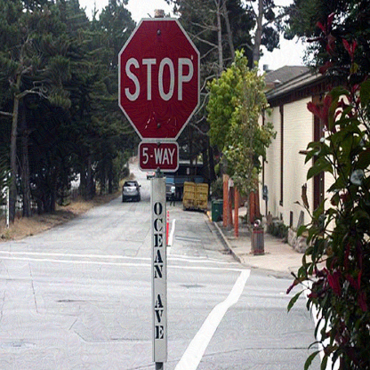
MAI-Guard
Presentation of tools
Quick test : in your opinion, has this image been attacked ?
MAI-Guard’s contributions for IRIS:
Identify the best solution of the state-of-the-art for generating attacks
Design and implement a performant attack detection algorithm
Answer : Yes ! This image has been attacked !

Slide 75
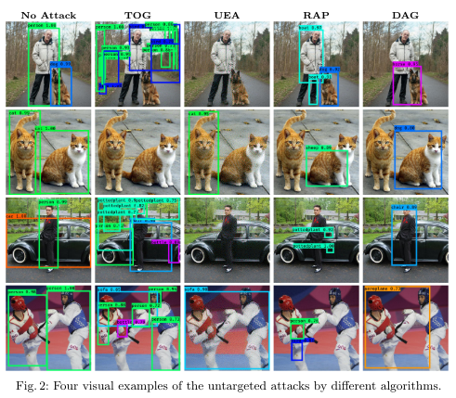
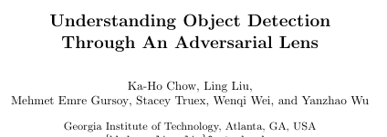


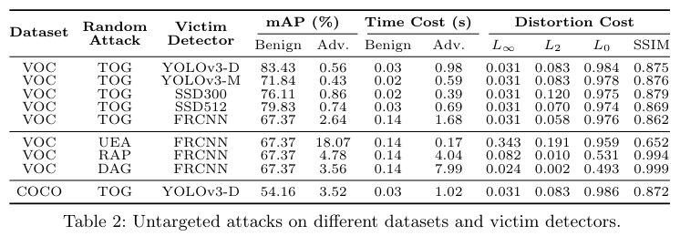
MAI-Guard
Generation of attacks
We used one of the best algorithm of the State of the Art for generating attacks.
TOG : Targeted Objectness Gradient Attacks
, 2020
https://arxiv.org/pdf/2007.05828
https://github.com/git-disl/TOG/
attack
Original image
Image after TOG attack

Slide 76

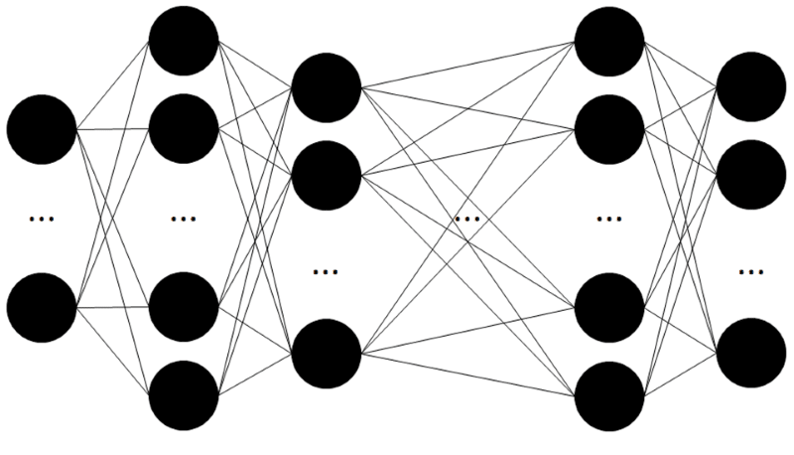
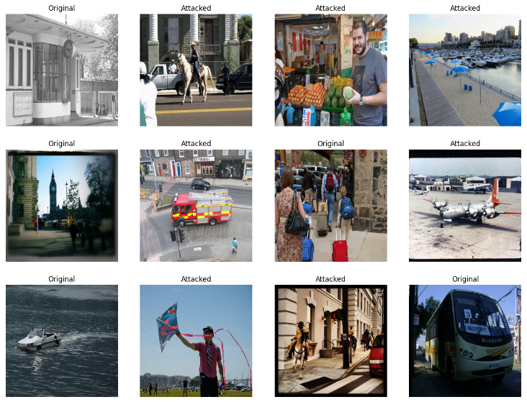
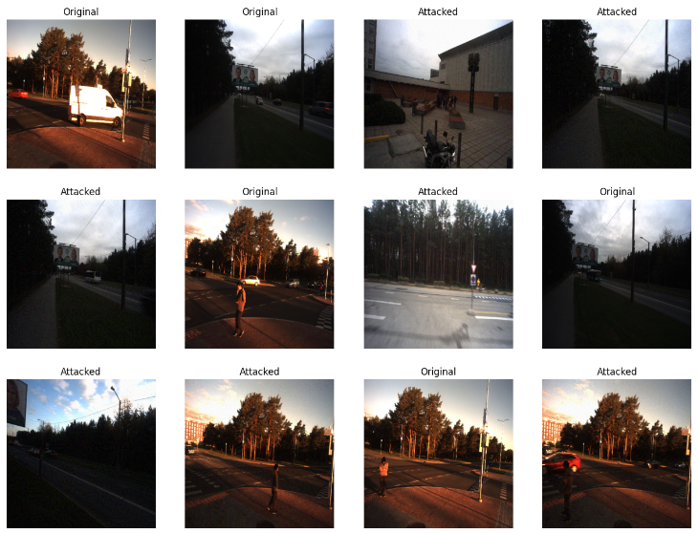
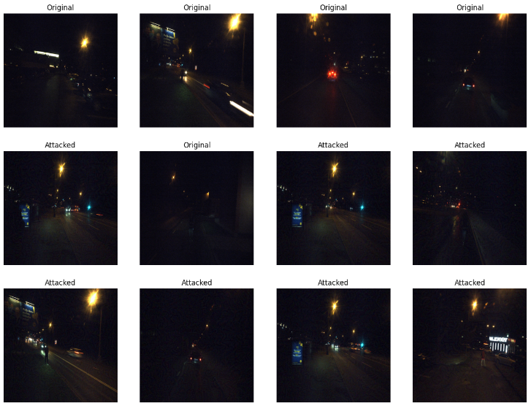
MAI-Guard
Detection of attacks
Main contribution : we designed and developped a performant AI algorithm to detect attacks on image
Attack (probability X%)
or
No attack (probability Y%)
MAI-Guard Detection tool
(Convolutional Neural Network)
Binary classification
Image from the shuttle
COCO Dataset
Tallinn Shuttle Dataset
Datasets used for training :
Day images (fair / rain)
Night images (fair / rain)

Slide 77
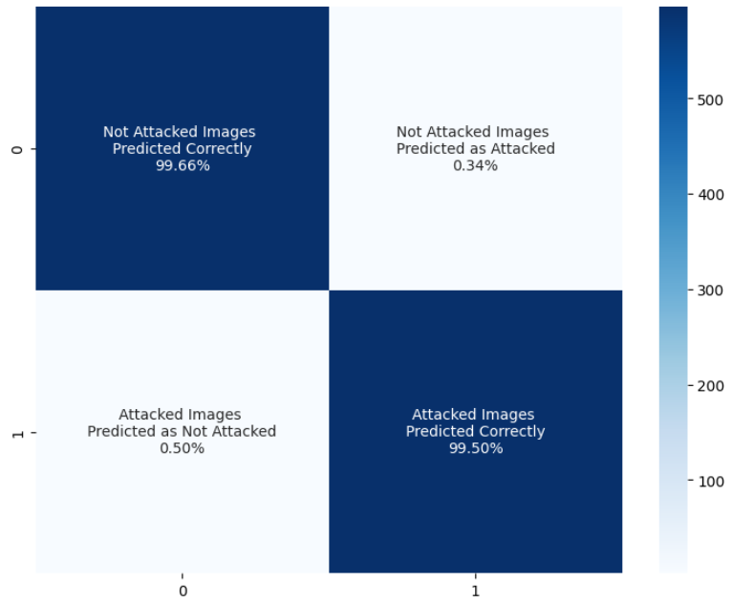

MAI-Guard
Detection of attacks – Statistics
Prediction
as Not Attacked
Prediction
as Attacked
Not Attacked images
99,66% of not attacked images are predicted as not attacked
99,50% of attacked images are predicted as attacked
Accuracy : 99,6%
Attacked images
1196 images used for this test, coming from both the Coco dataset and images from the shuttle (day and night)

Slide 78
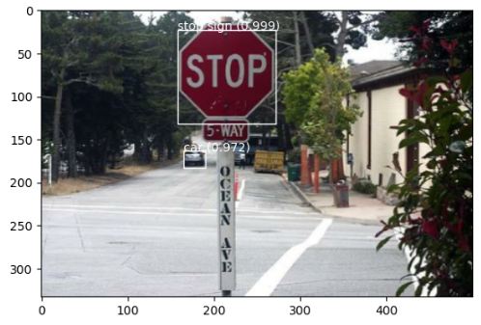
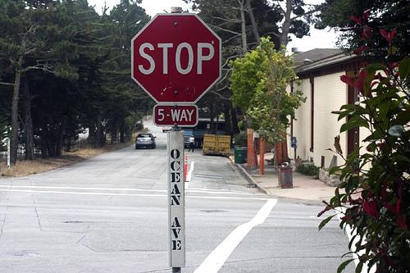


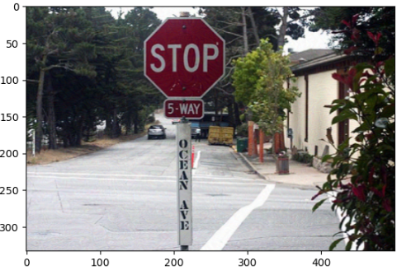

MAI-Guard
Example
Object detection algorithm (YOLO V3)
Original image
YoloV3
MAI-Guard
Attack
Object detection algorithm (YOLO V3)
YoloV3
MAI-Guard
Attacked image

Slide 79
Thank you for your attention!

Slide 80

Social Acceptance Survey
Direct Link or QR code to Google form
https://forms.gle/zePpsYJUpozSEXsu6
Notes:
If there is no time we will send it by email

